Slide 1
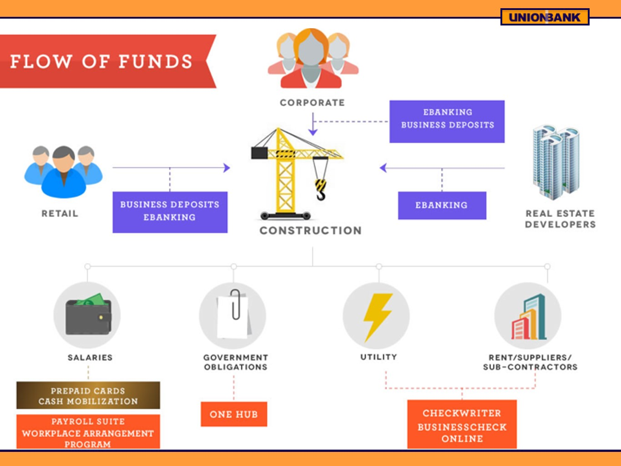

Slide 2
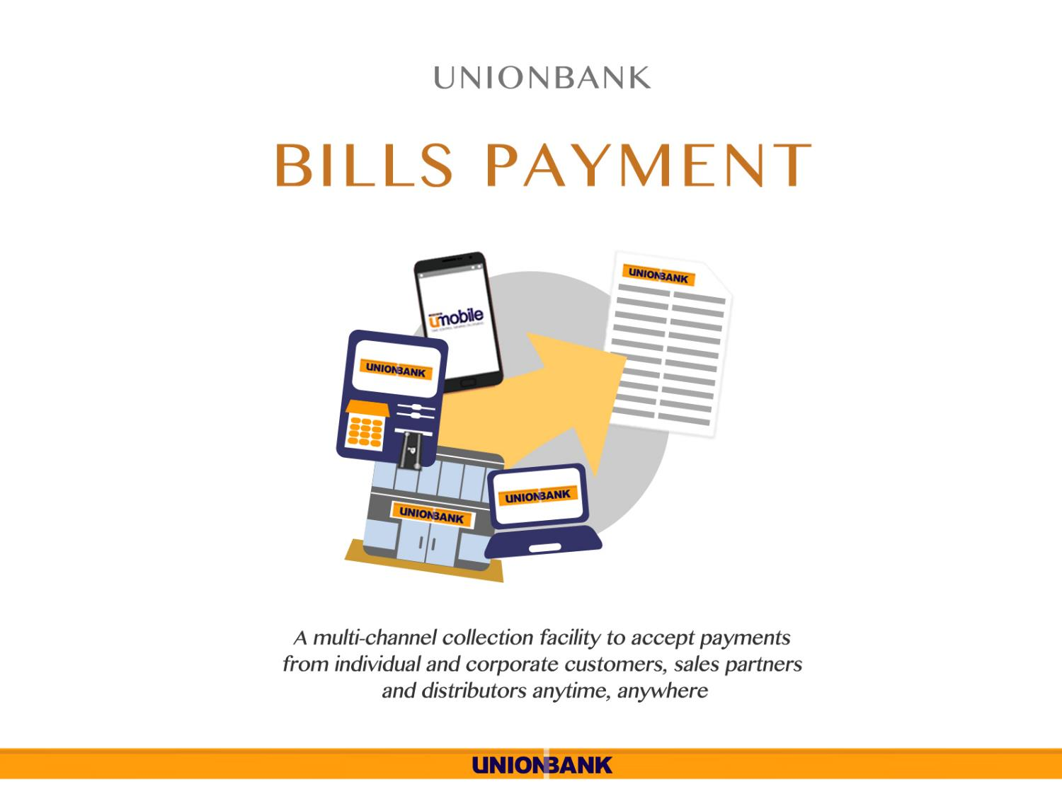

Slide 3
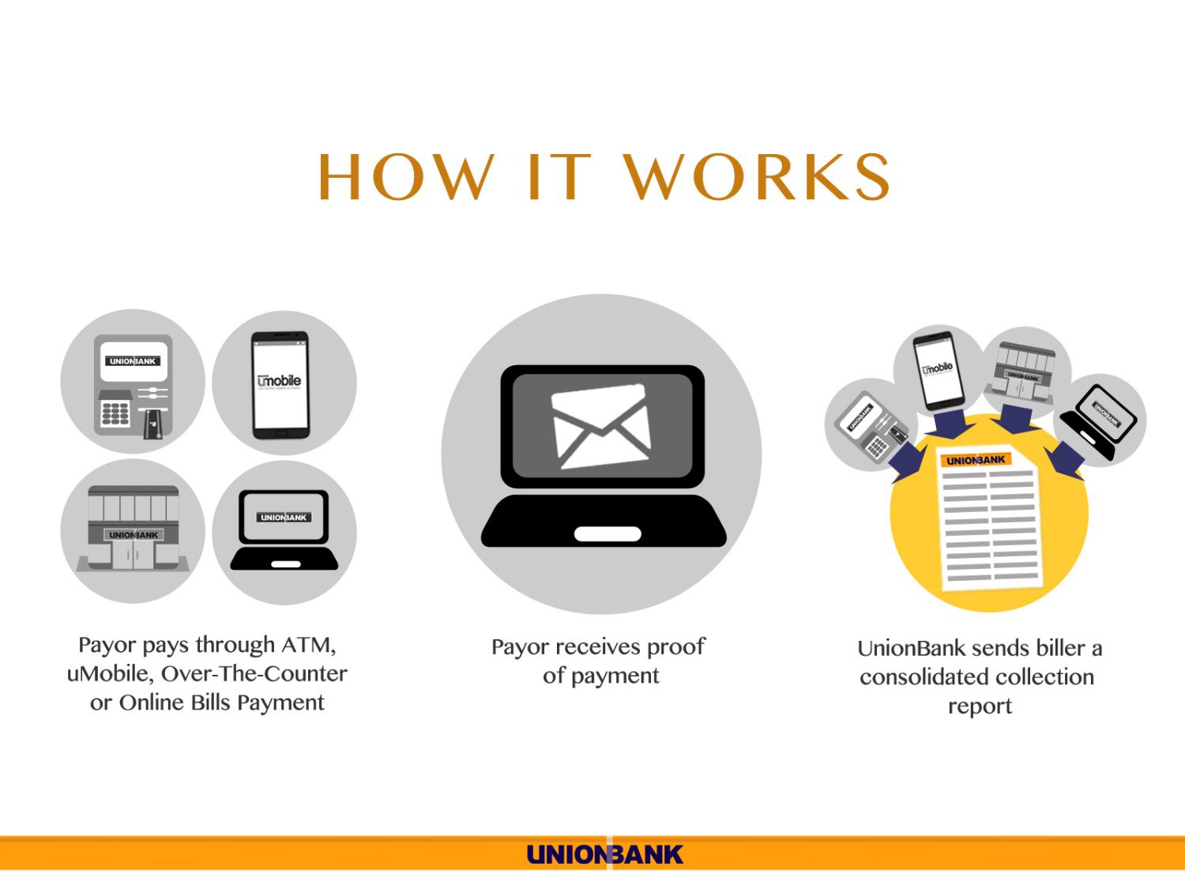

Slide 4
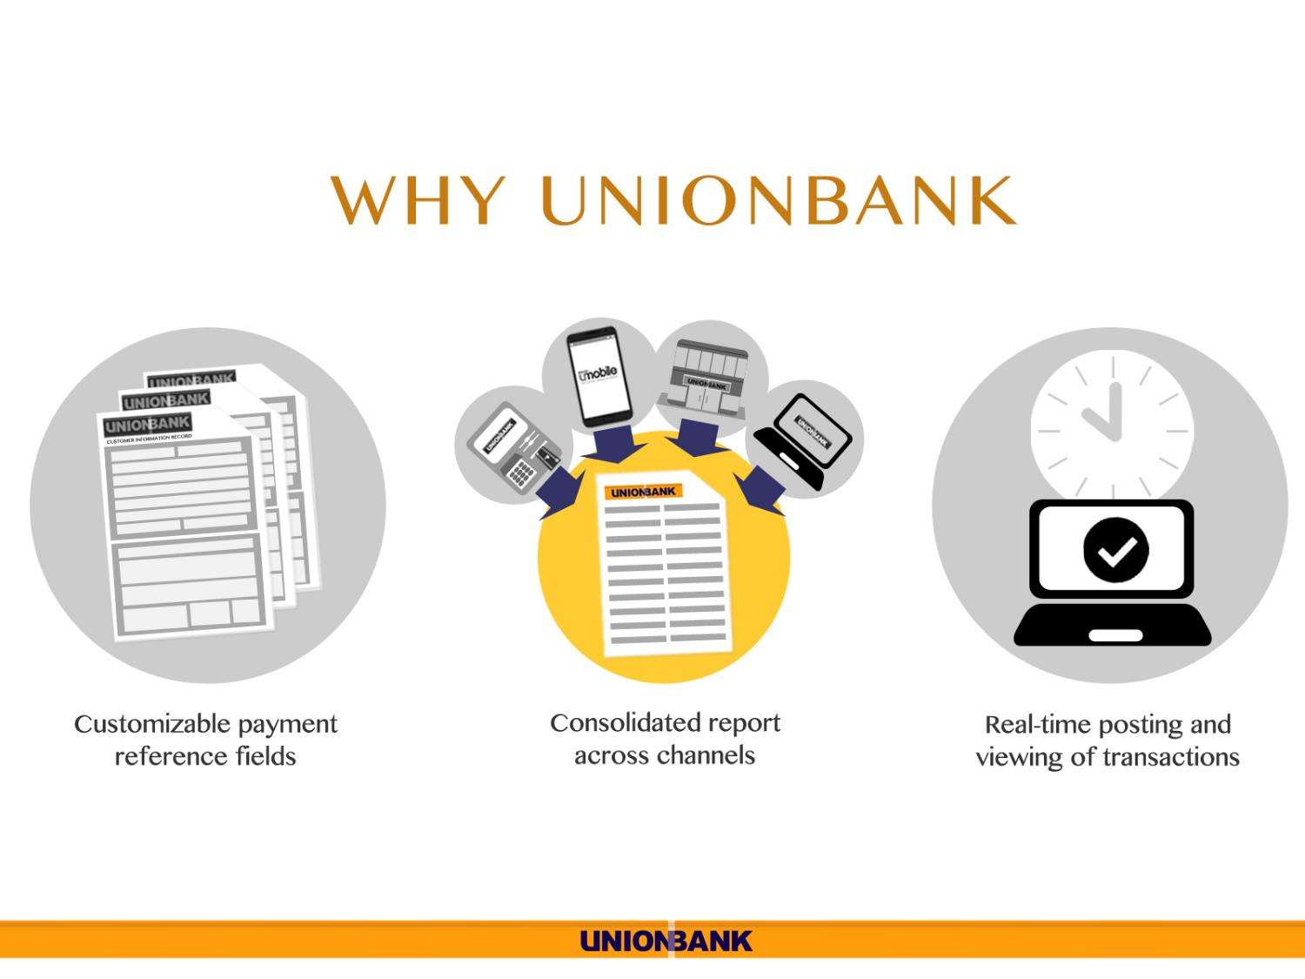


Slide 5
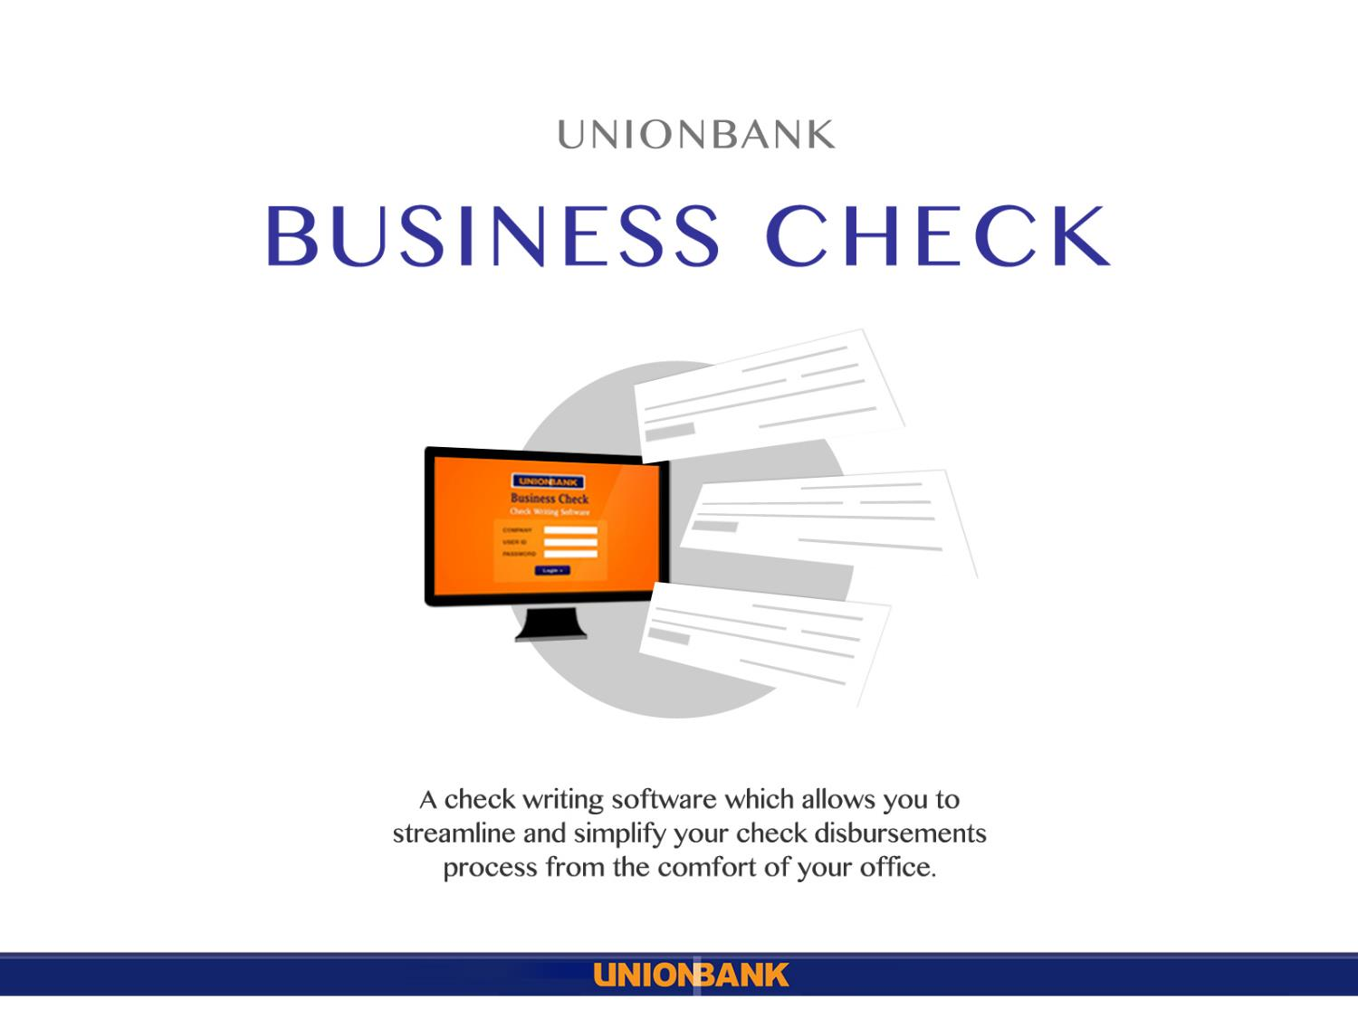

Slide 6
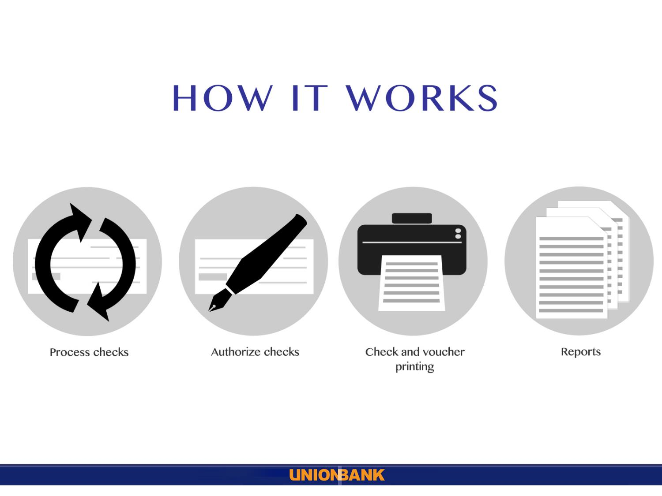

Slide 7
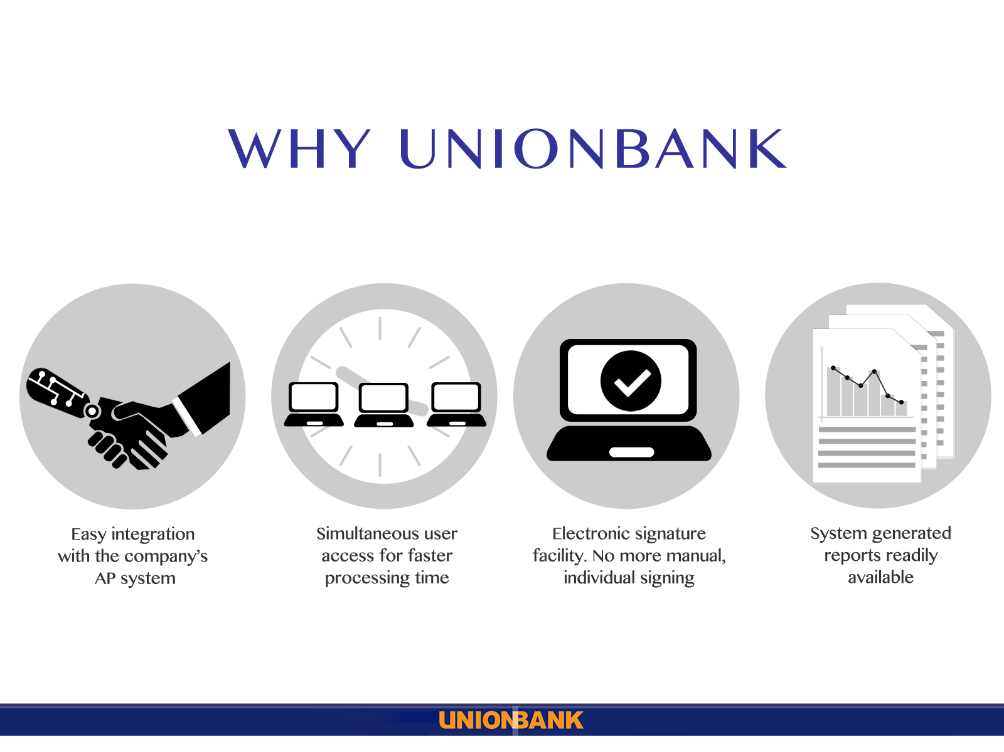

Slide 8
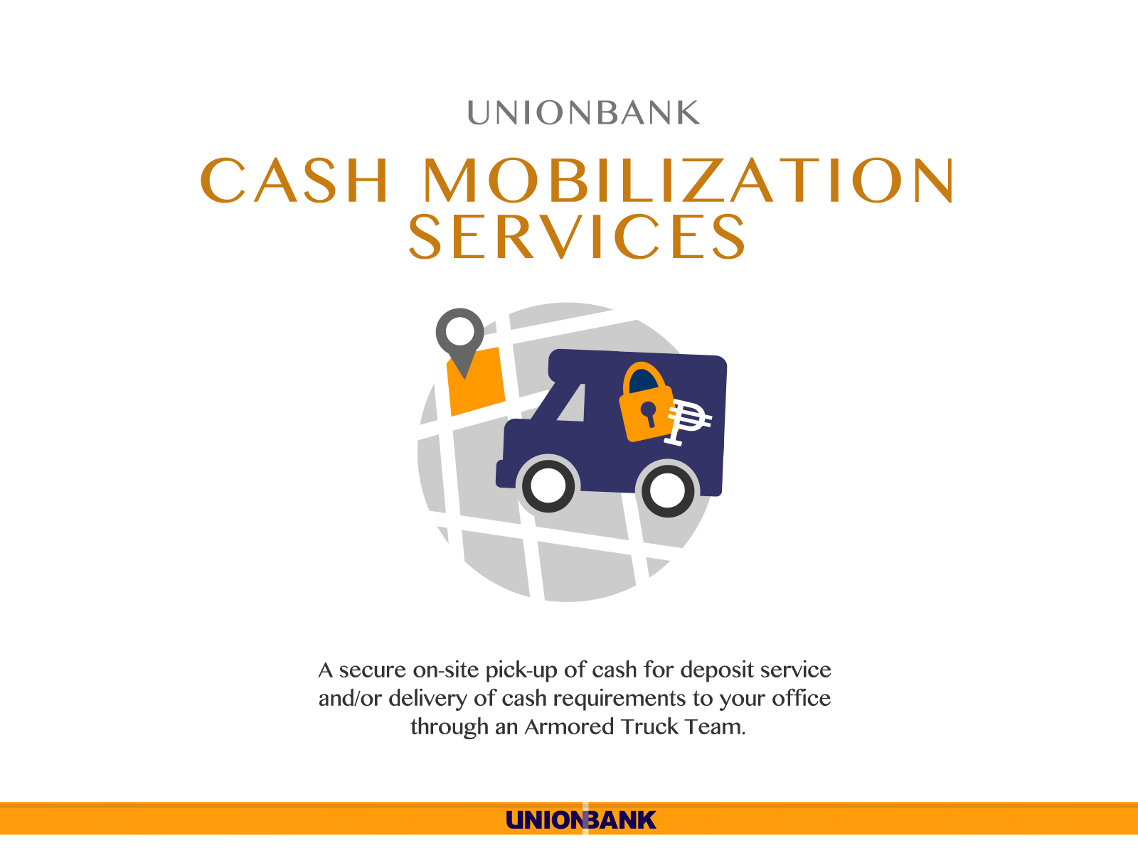

Slide 9
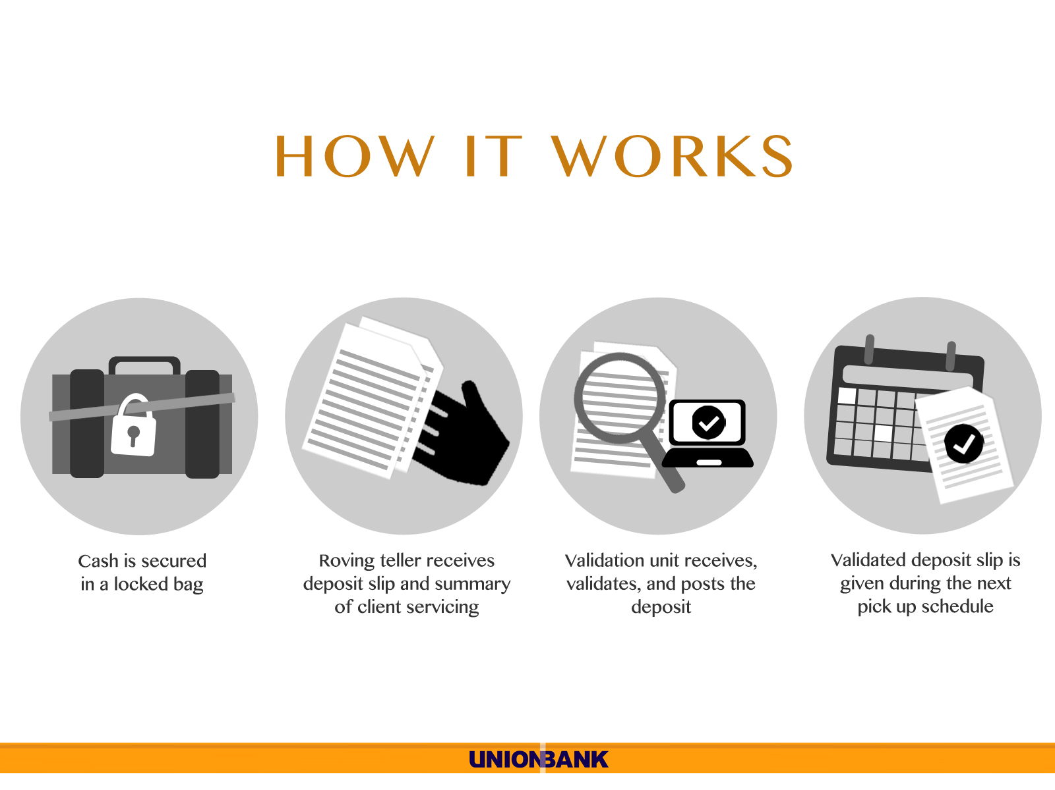

Slide 10
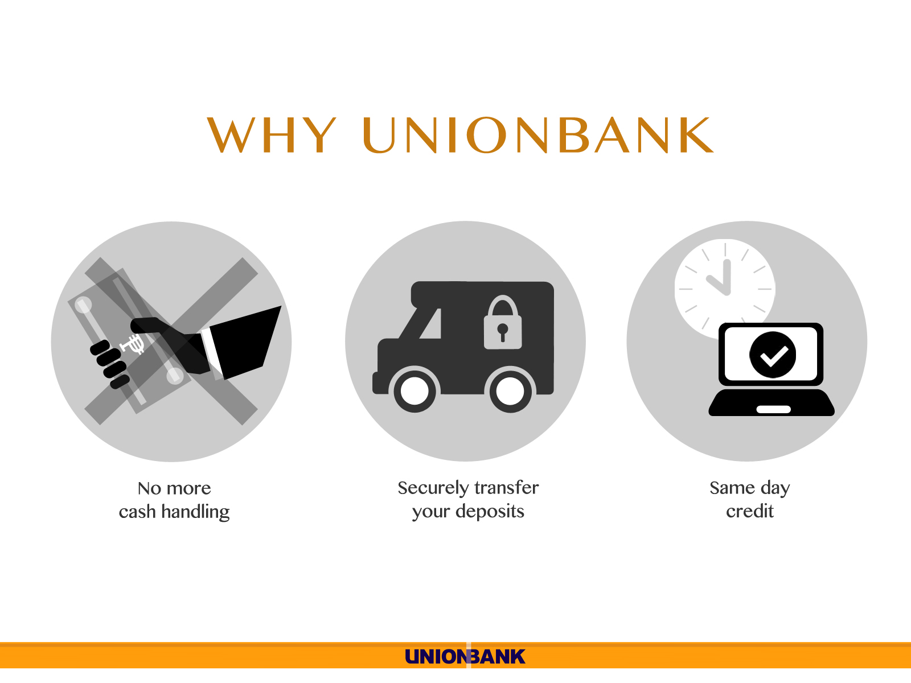

Slide 11
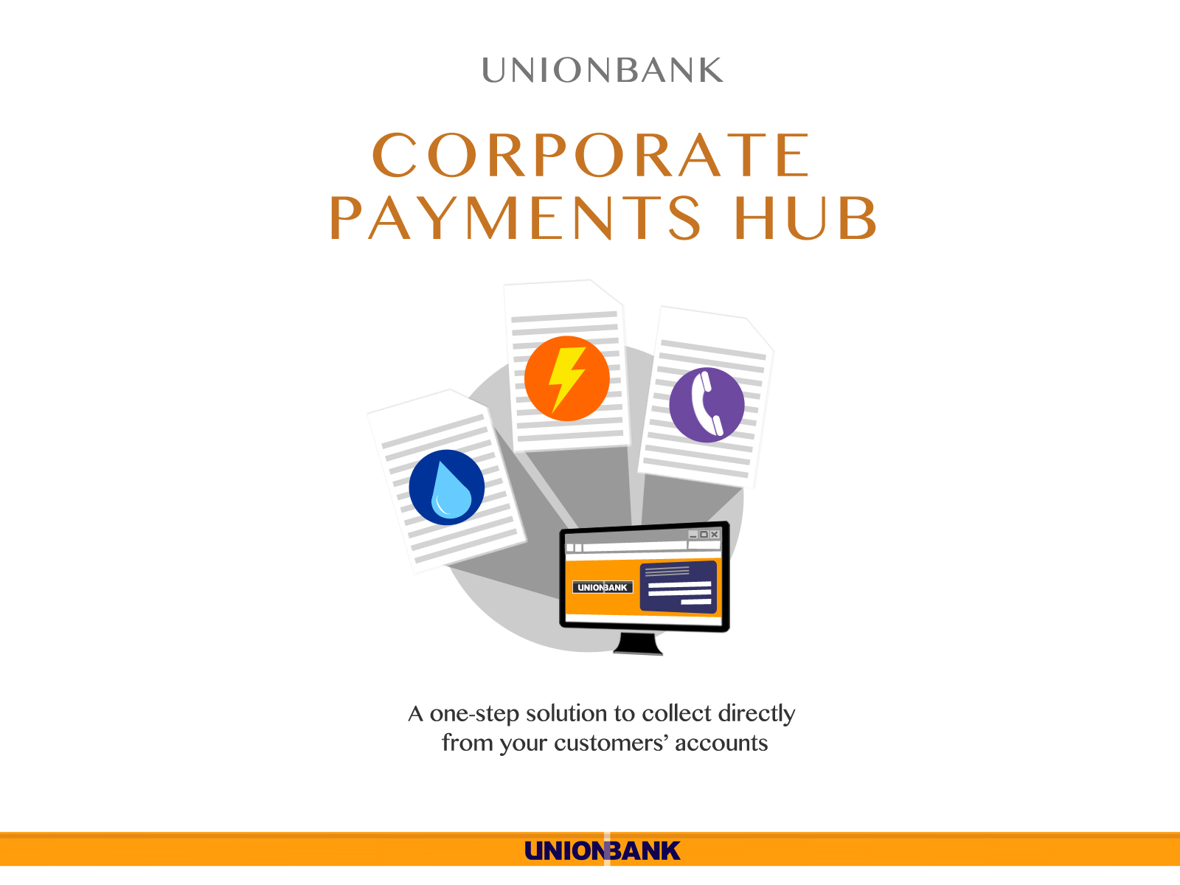

Slide 12
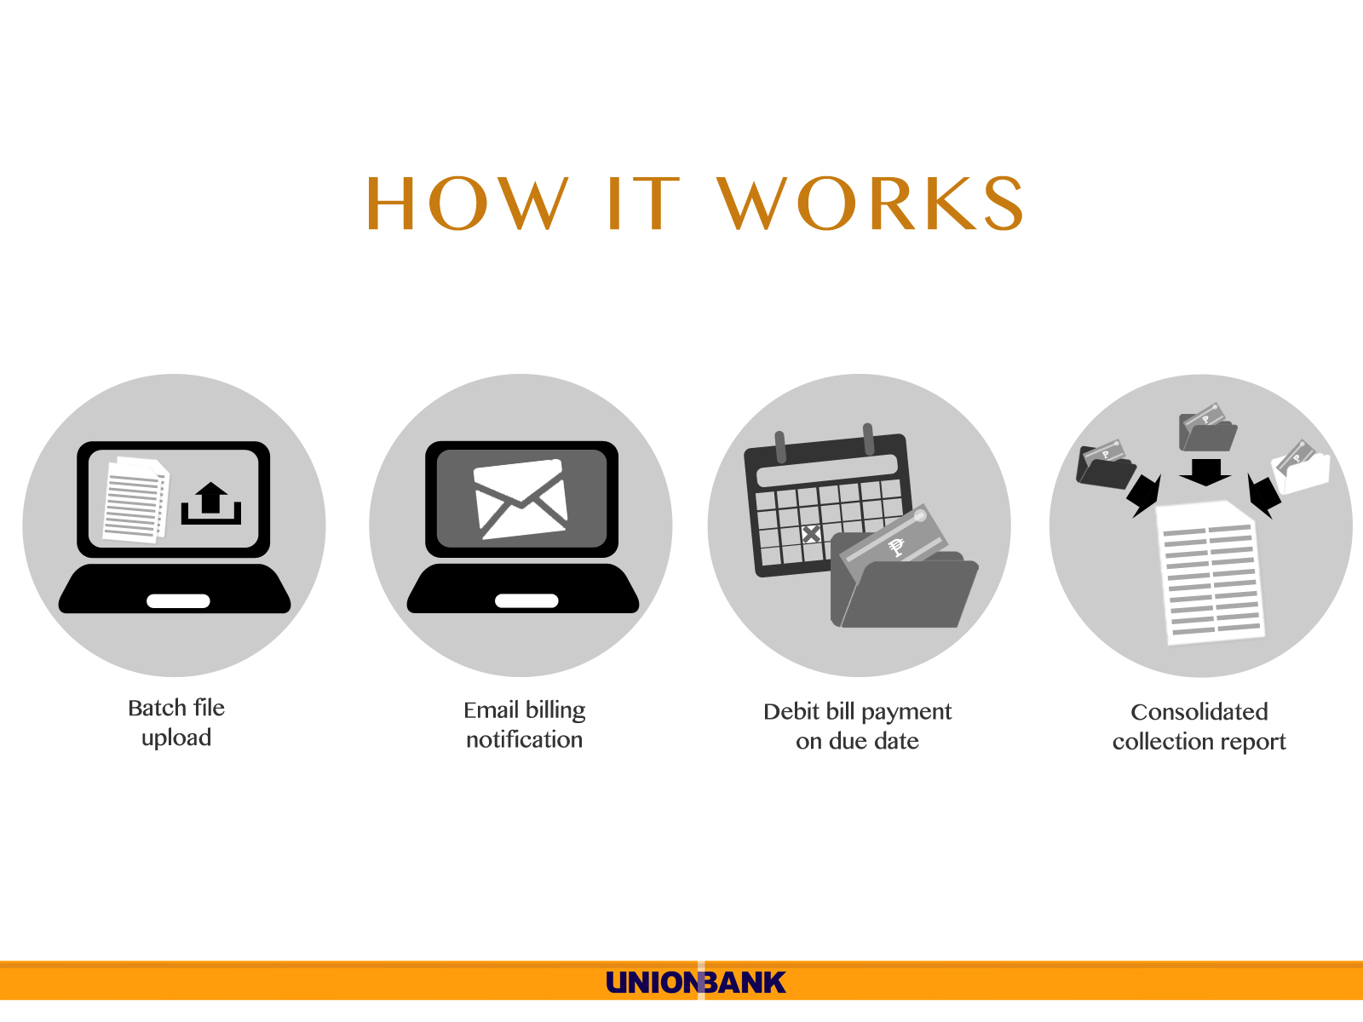

Slide 13
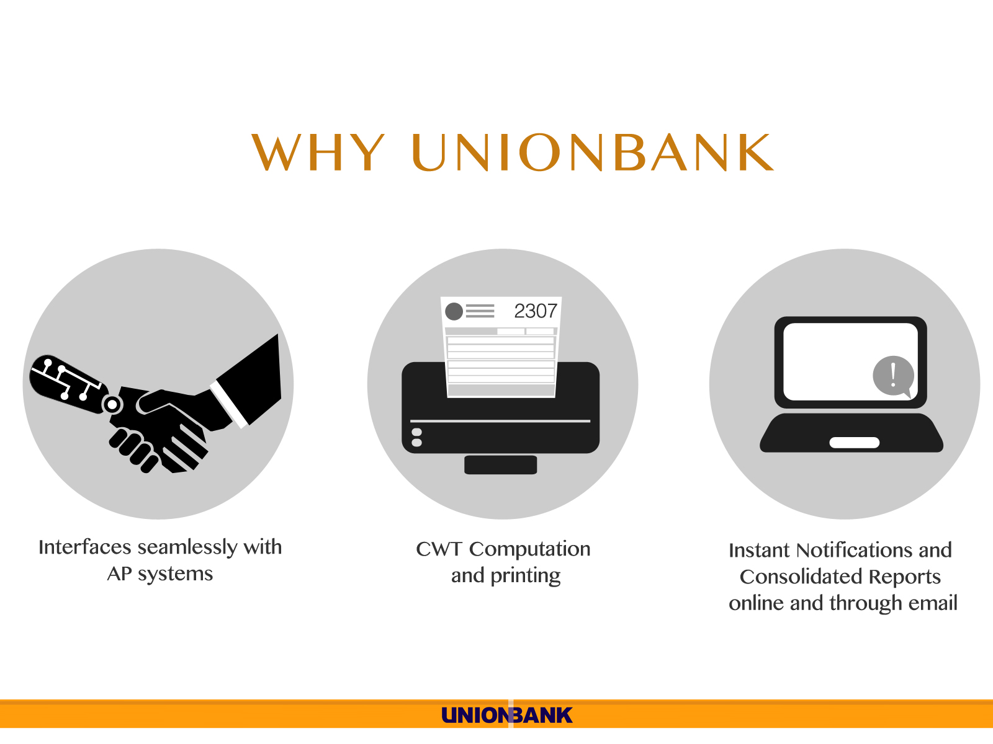

Slide 14
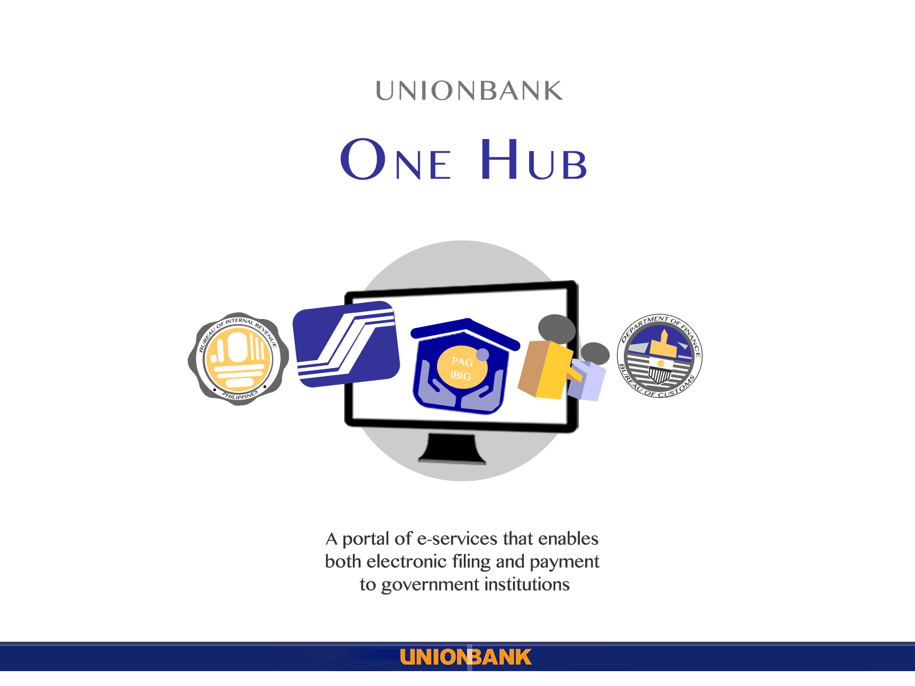

Slide 15
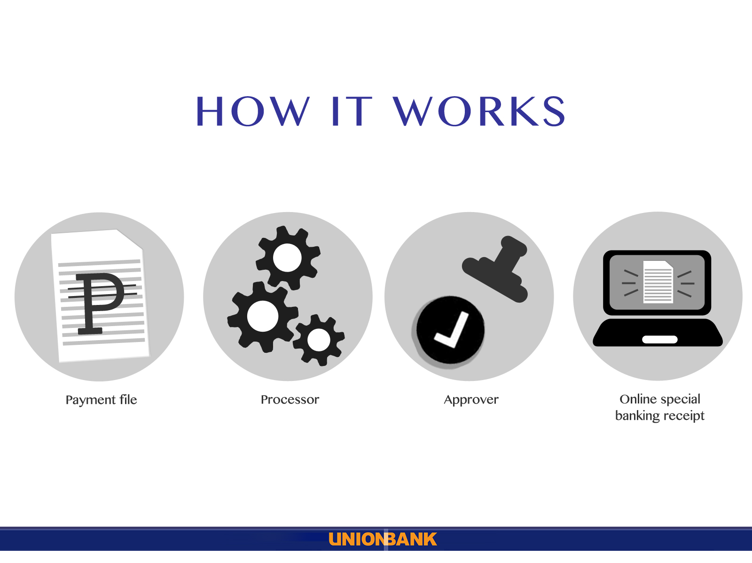

Slide 16
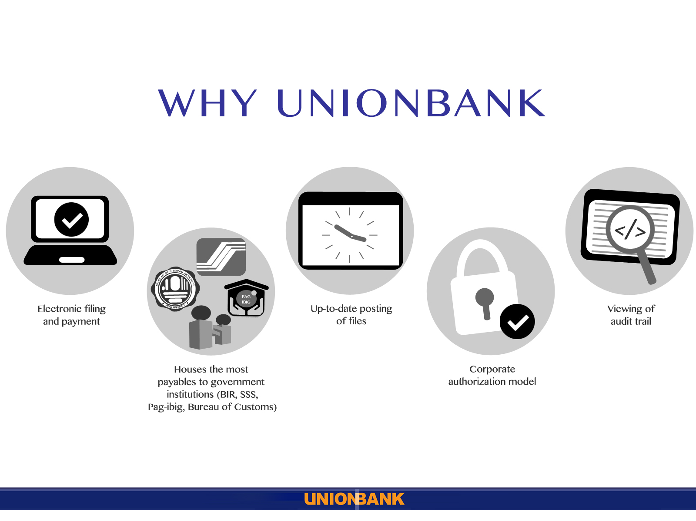

Slide 17
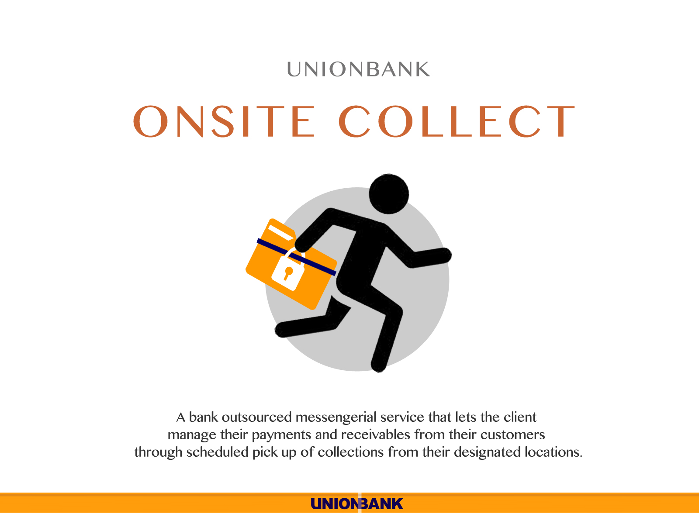

Slide 18
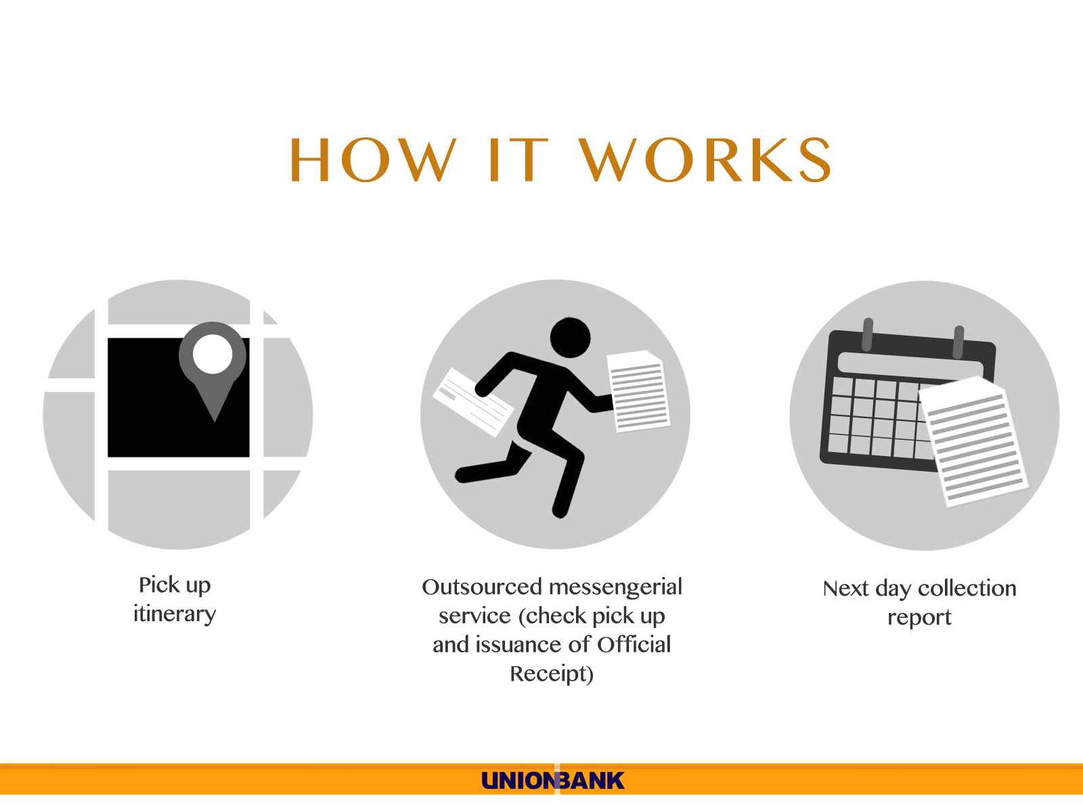

Slide 19
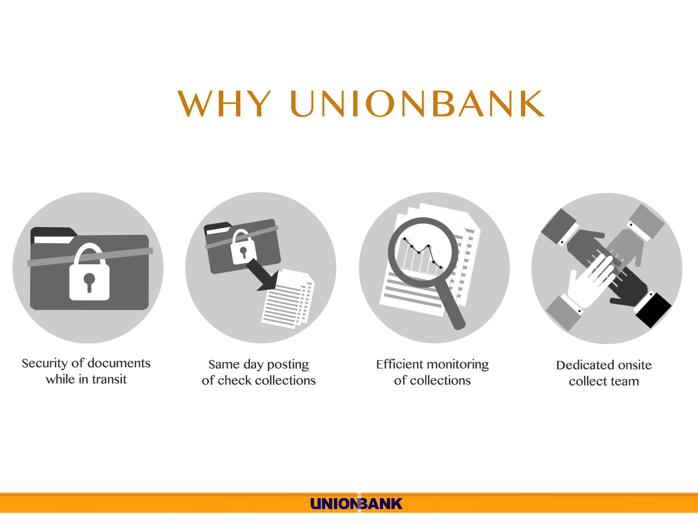

Slide 20


Slide 21
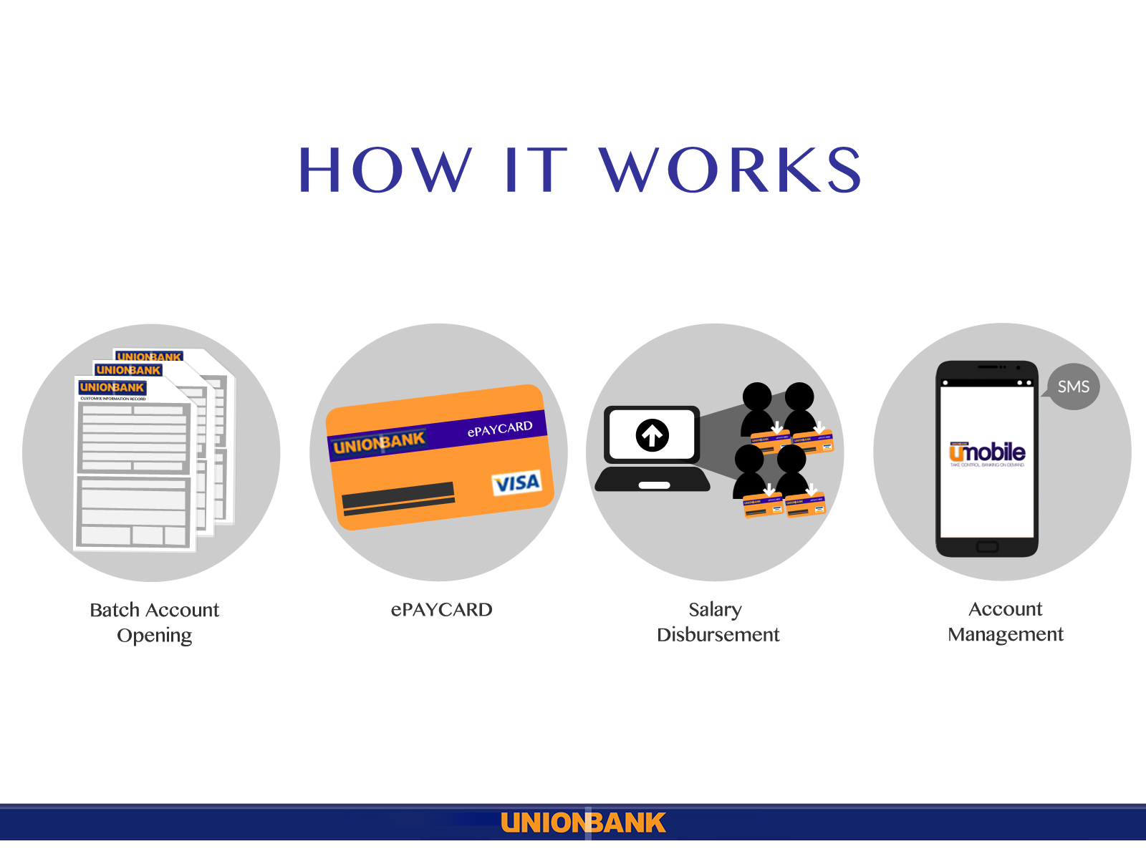

Slide 22
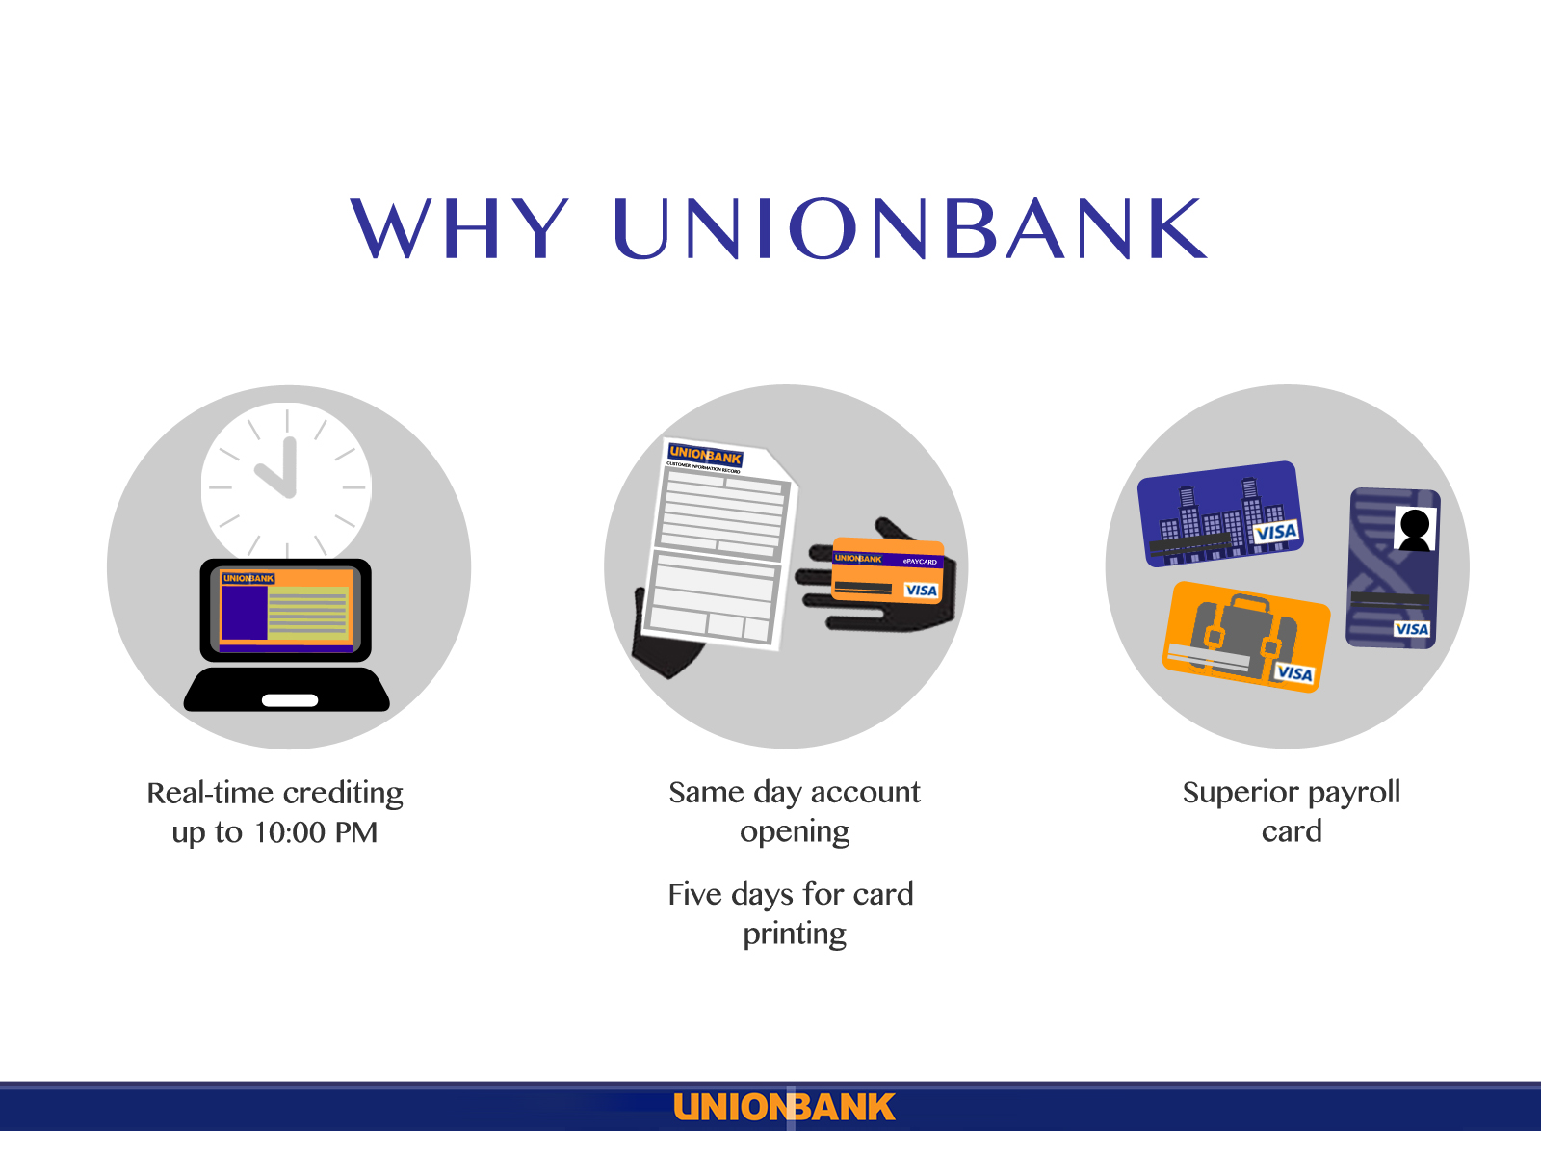

Slide 23
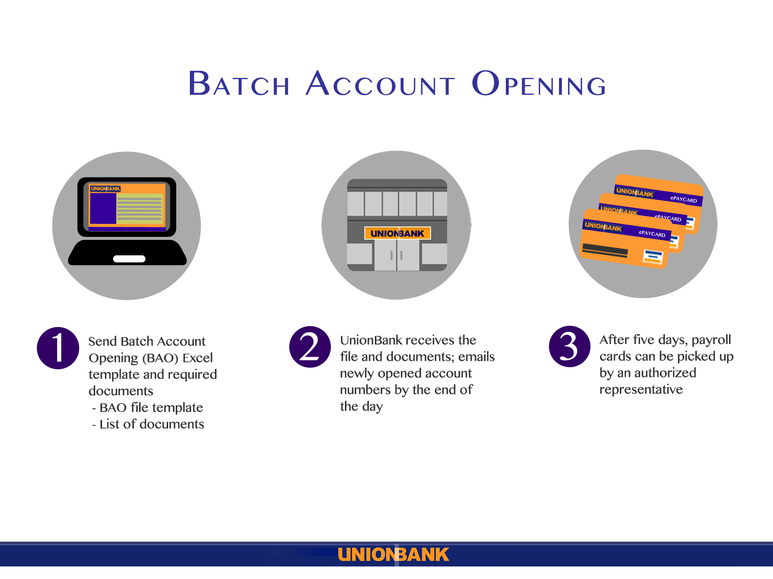

Slide 24
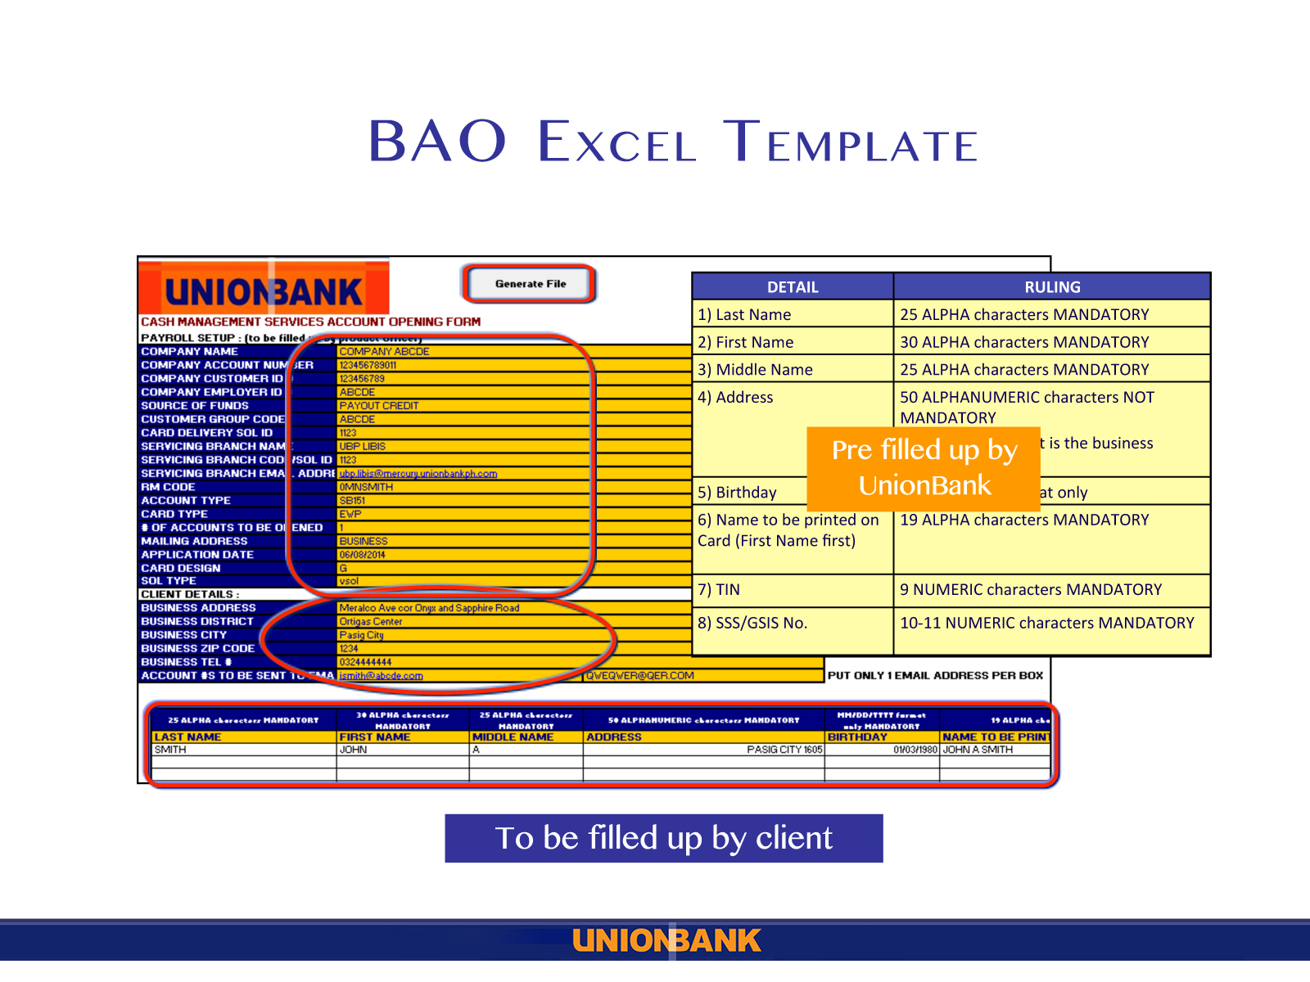

Slide 25
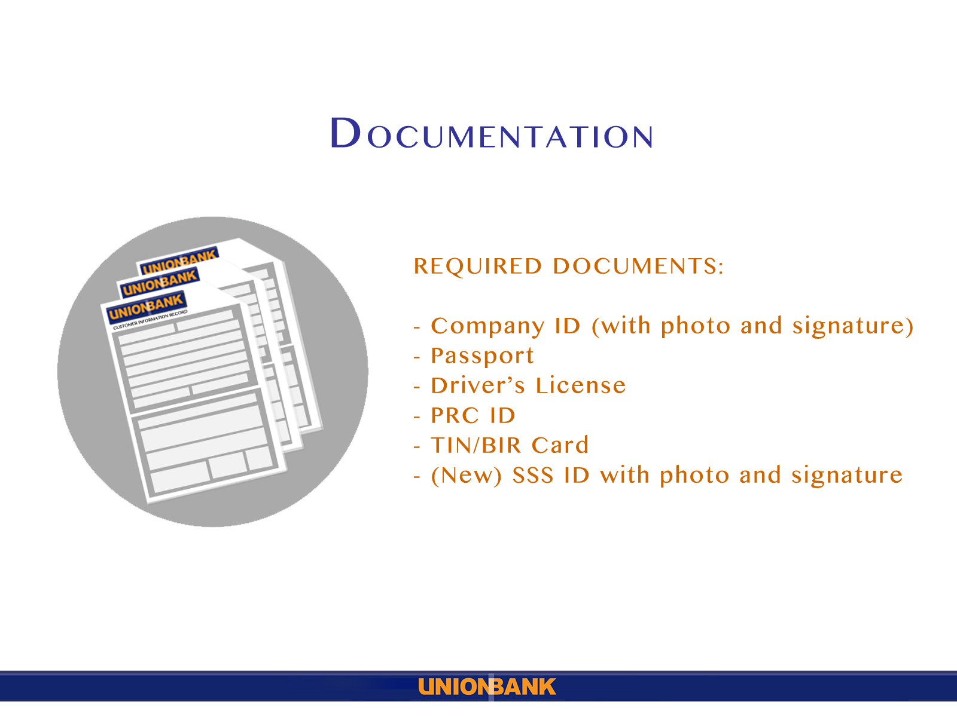

Slide 26
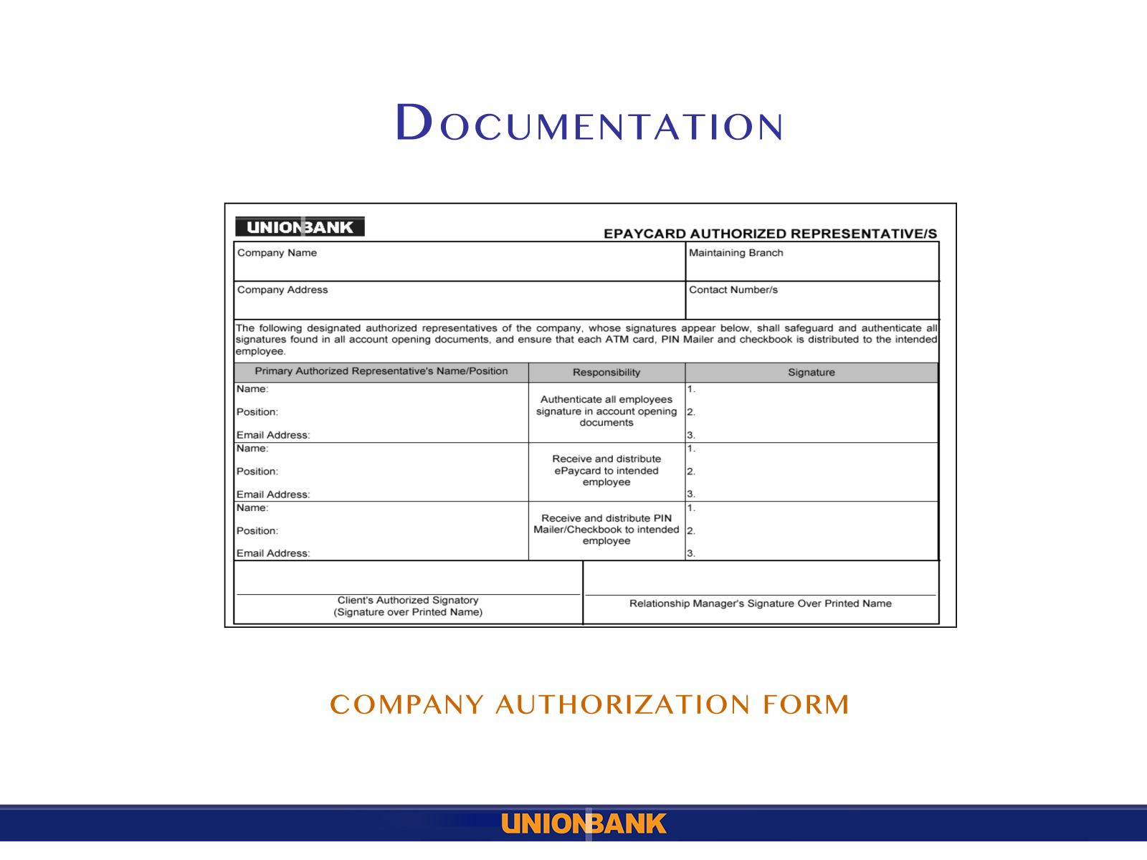

Slide 27
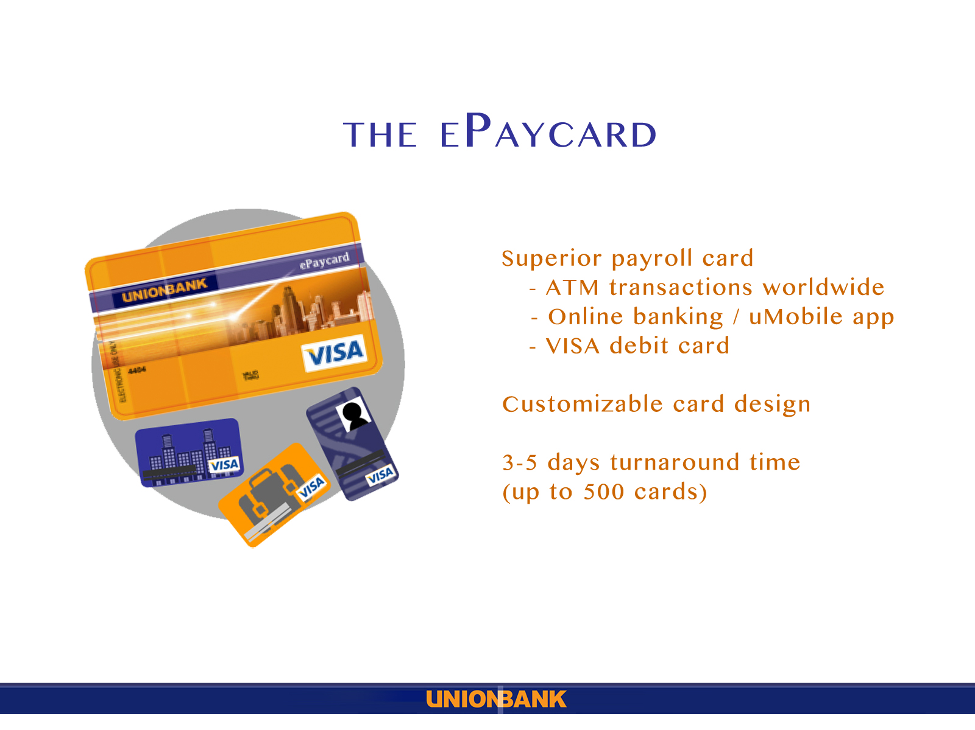

Slide 28
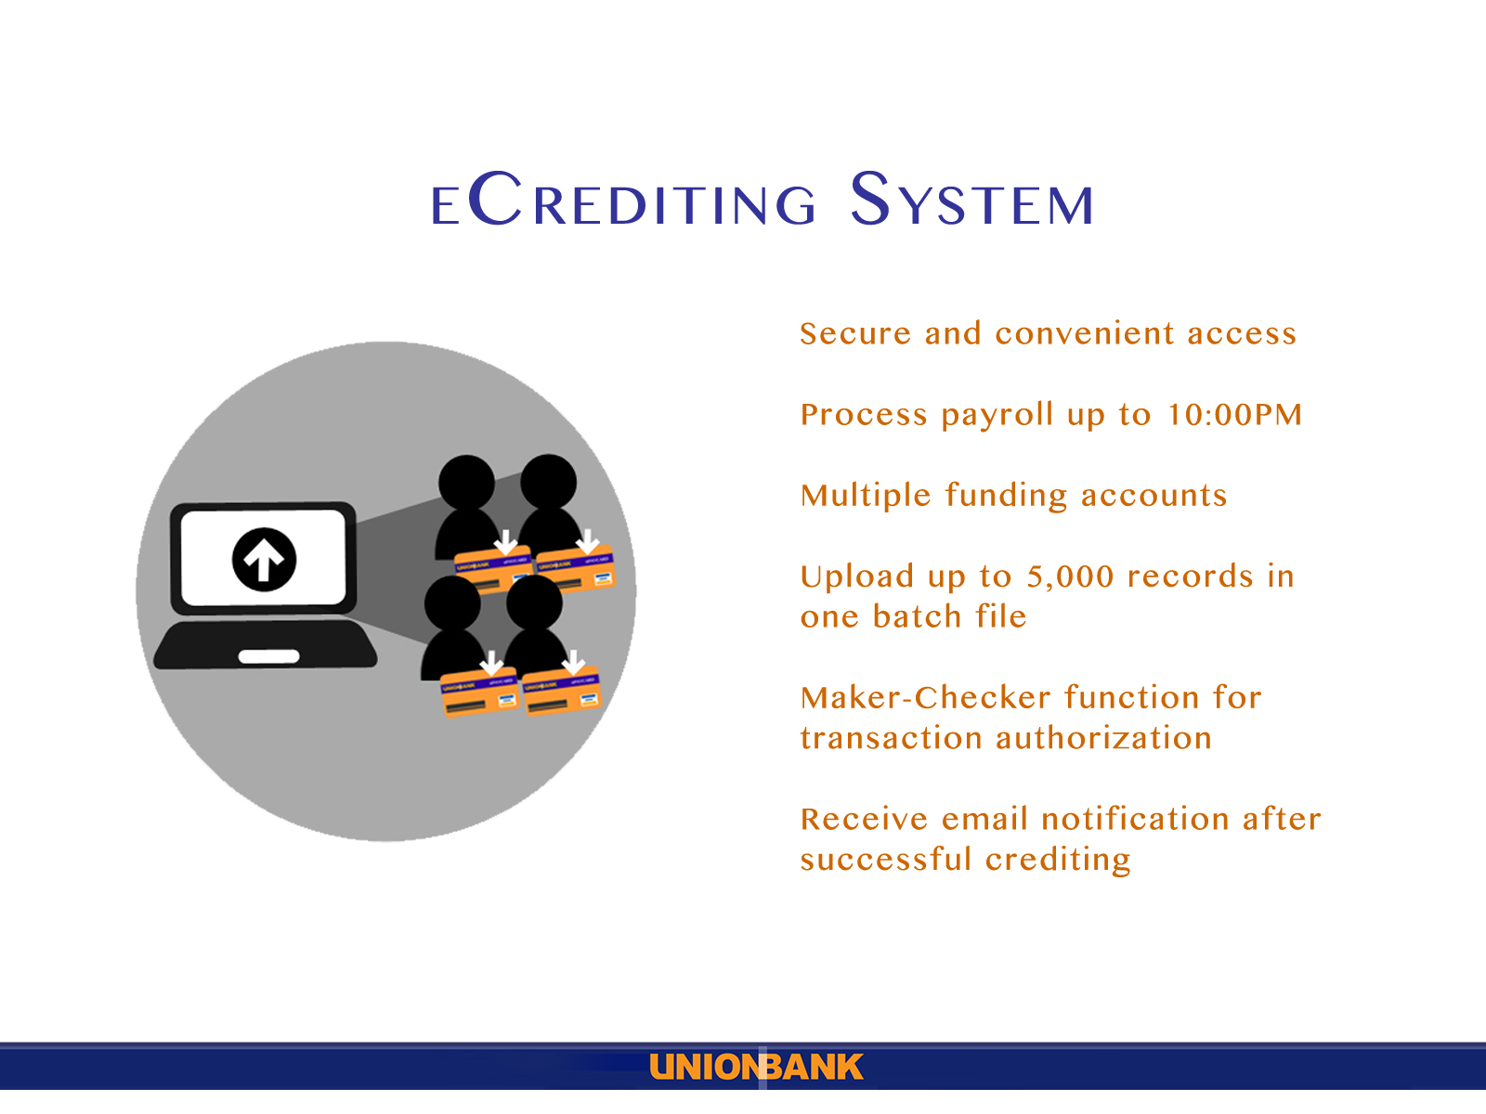

Slide 29
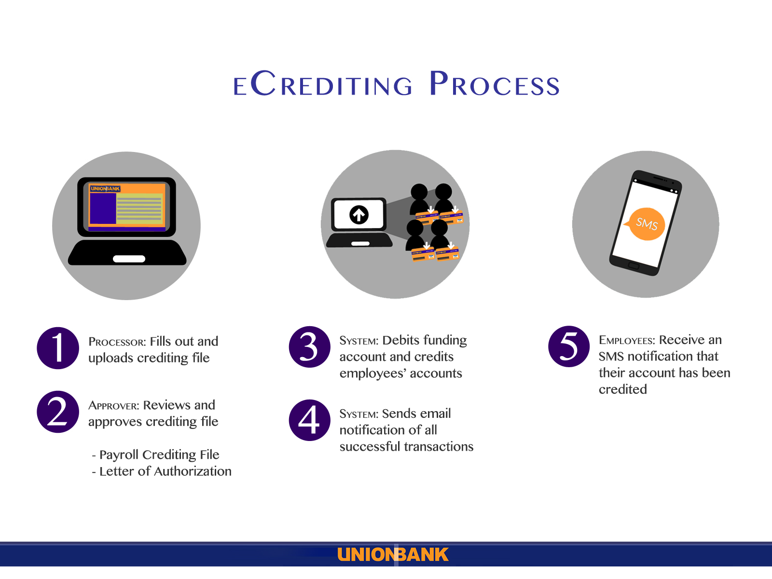

Slide 30
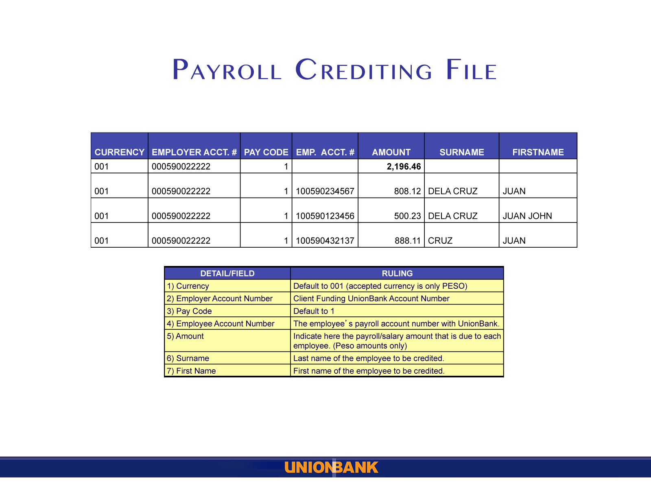

Slide 31
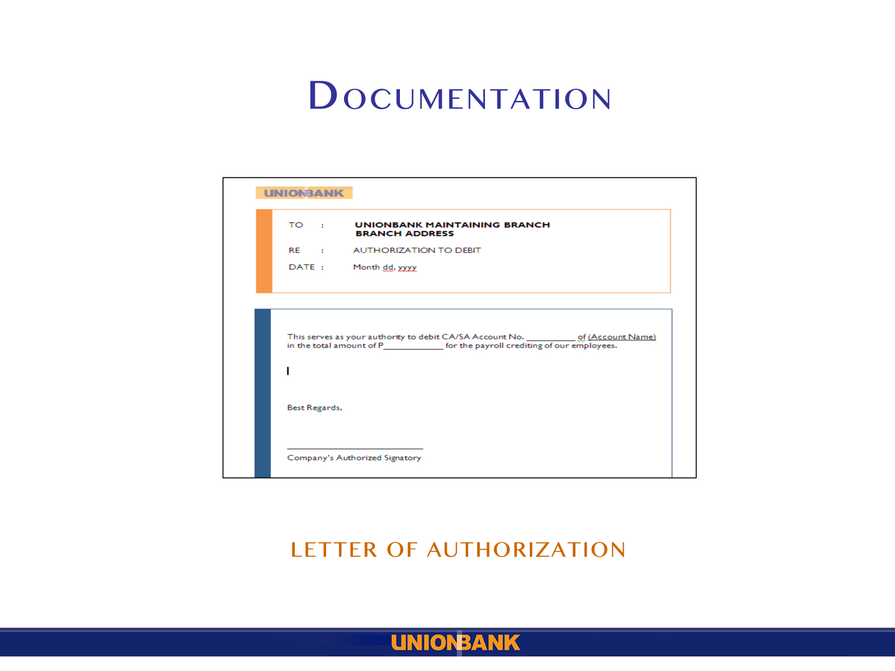

Slide 32
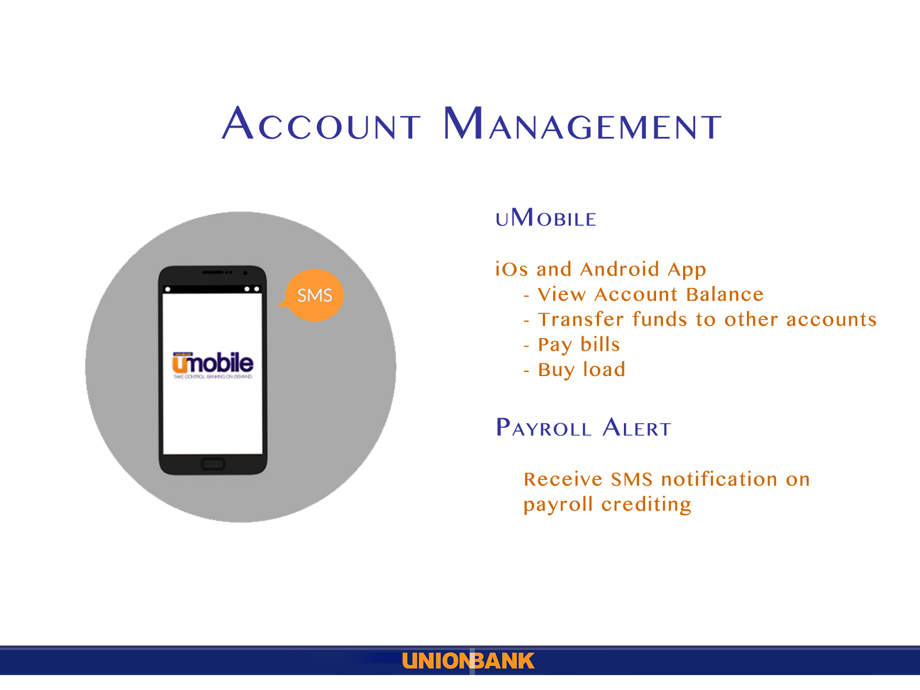

Slide 33
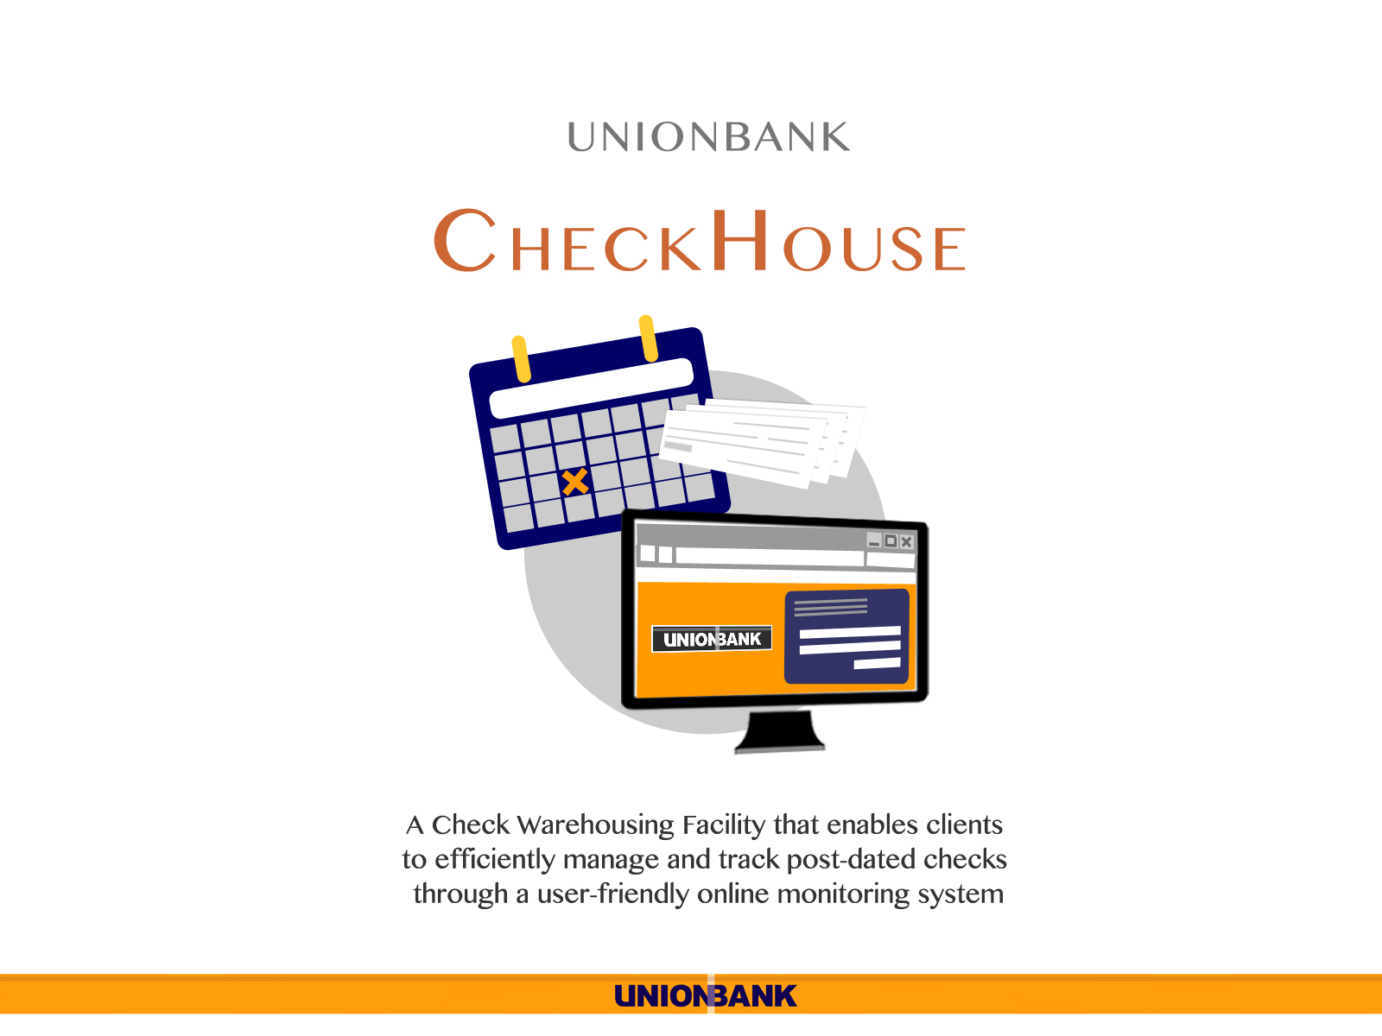

Slide 34
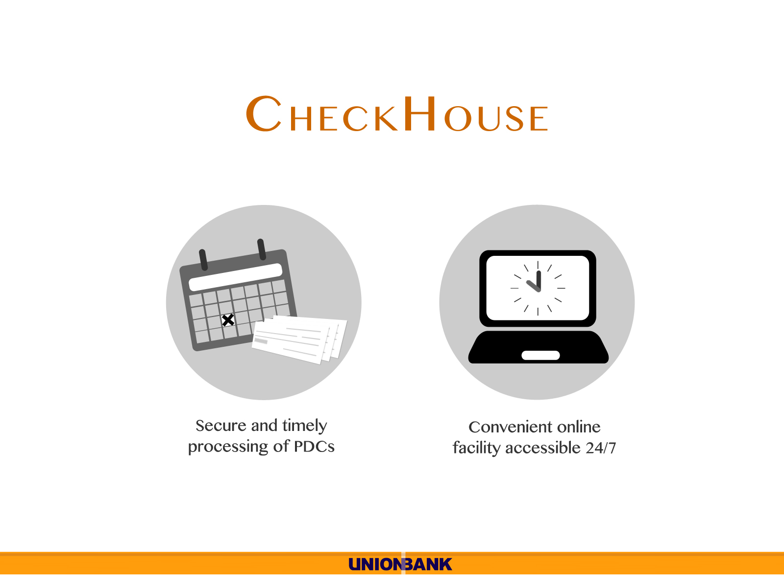

Slide 35
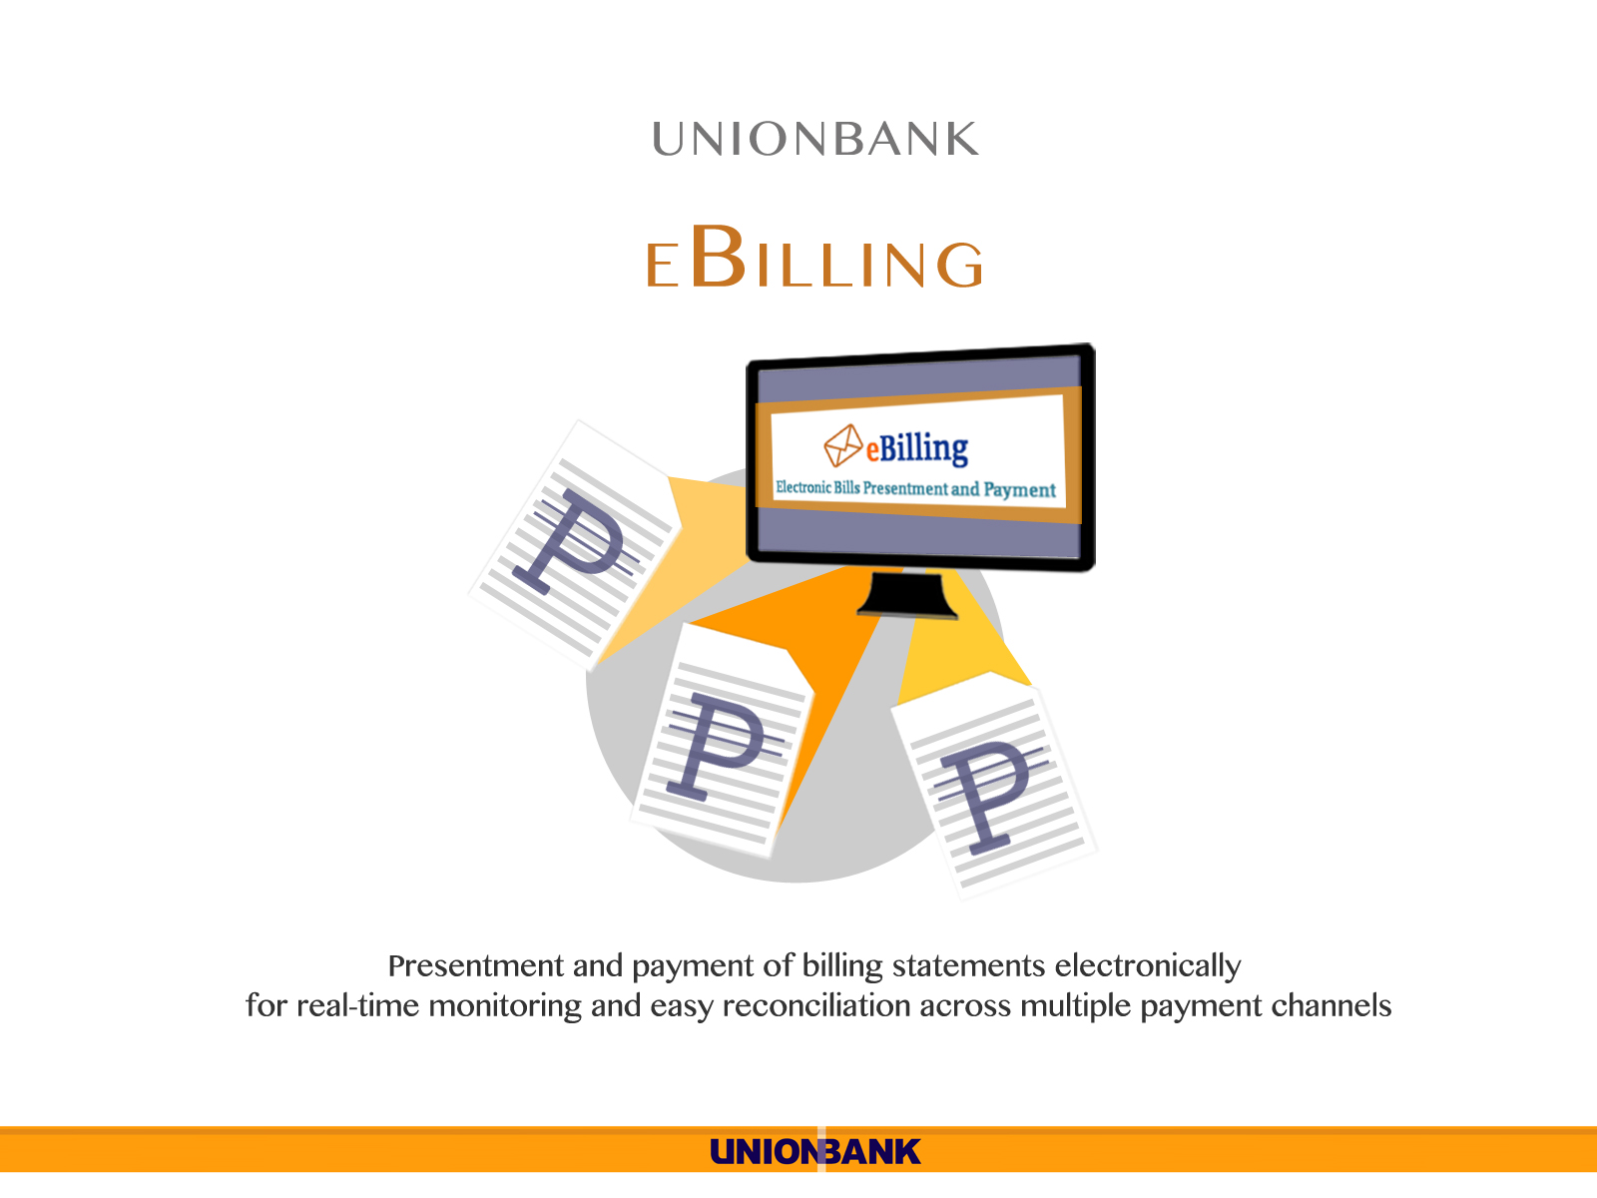

Slide 36
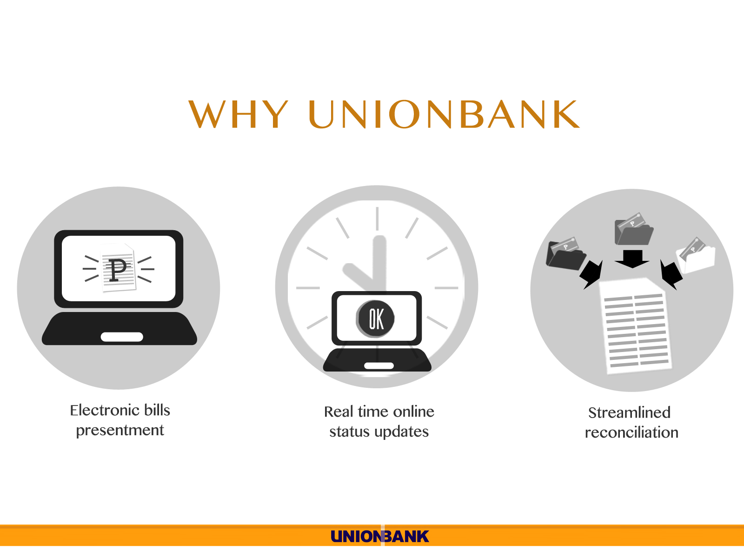

Slide 37
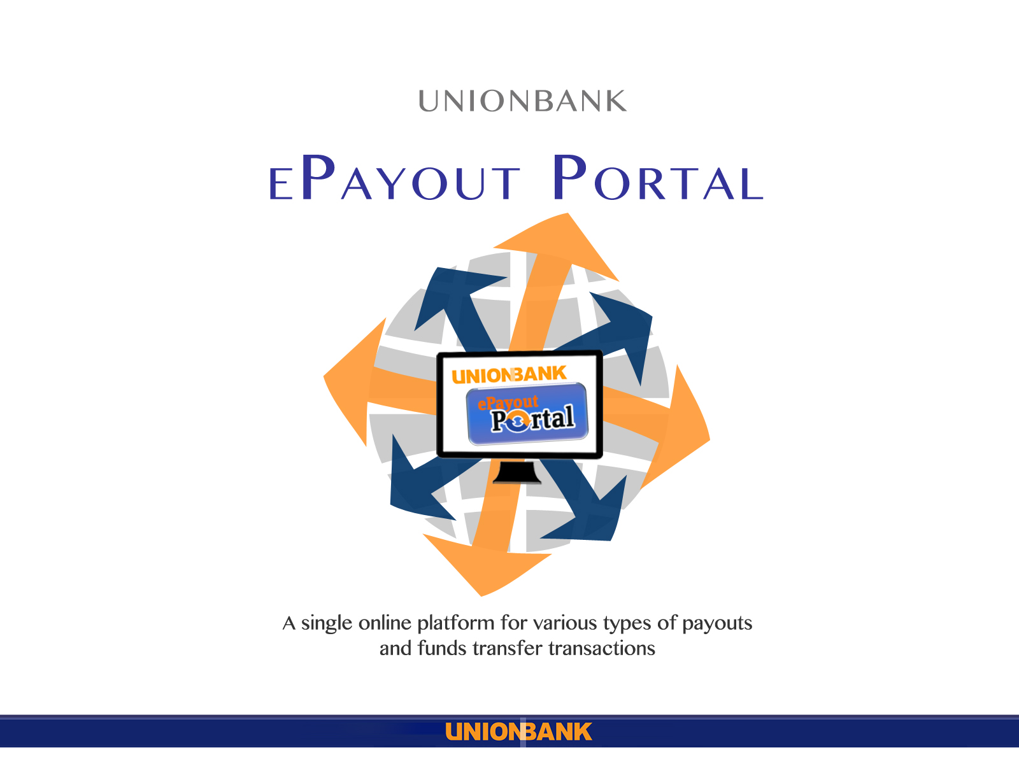

Slide 38
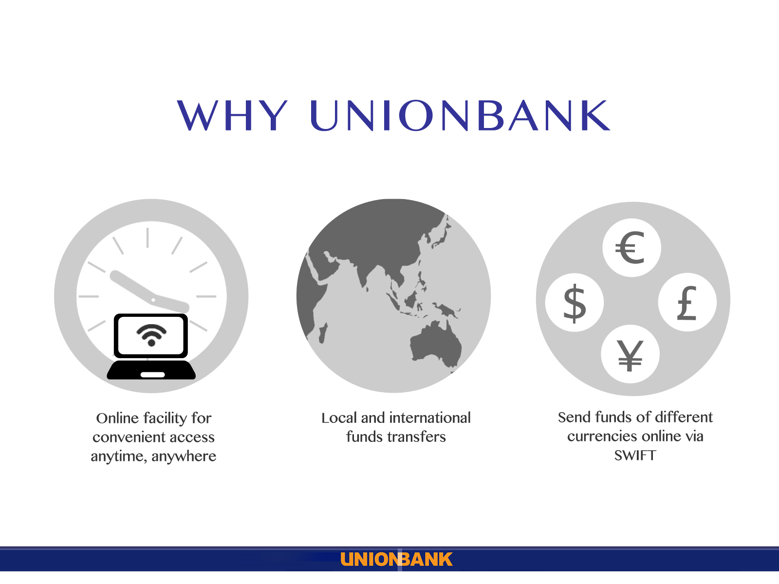

Slide 39
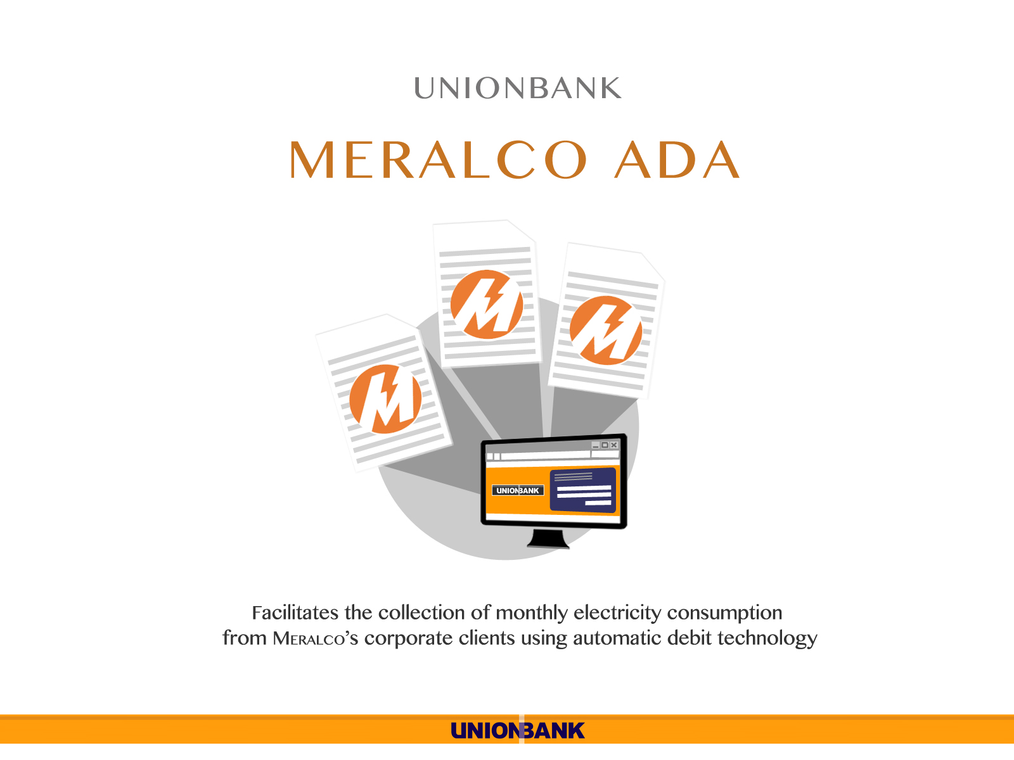

Slide 40
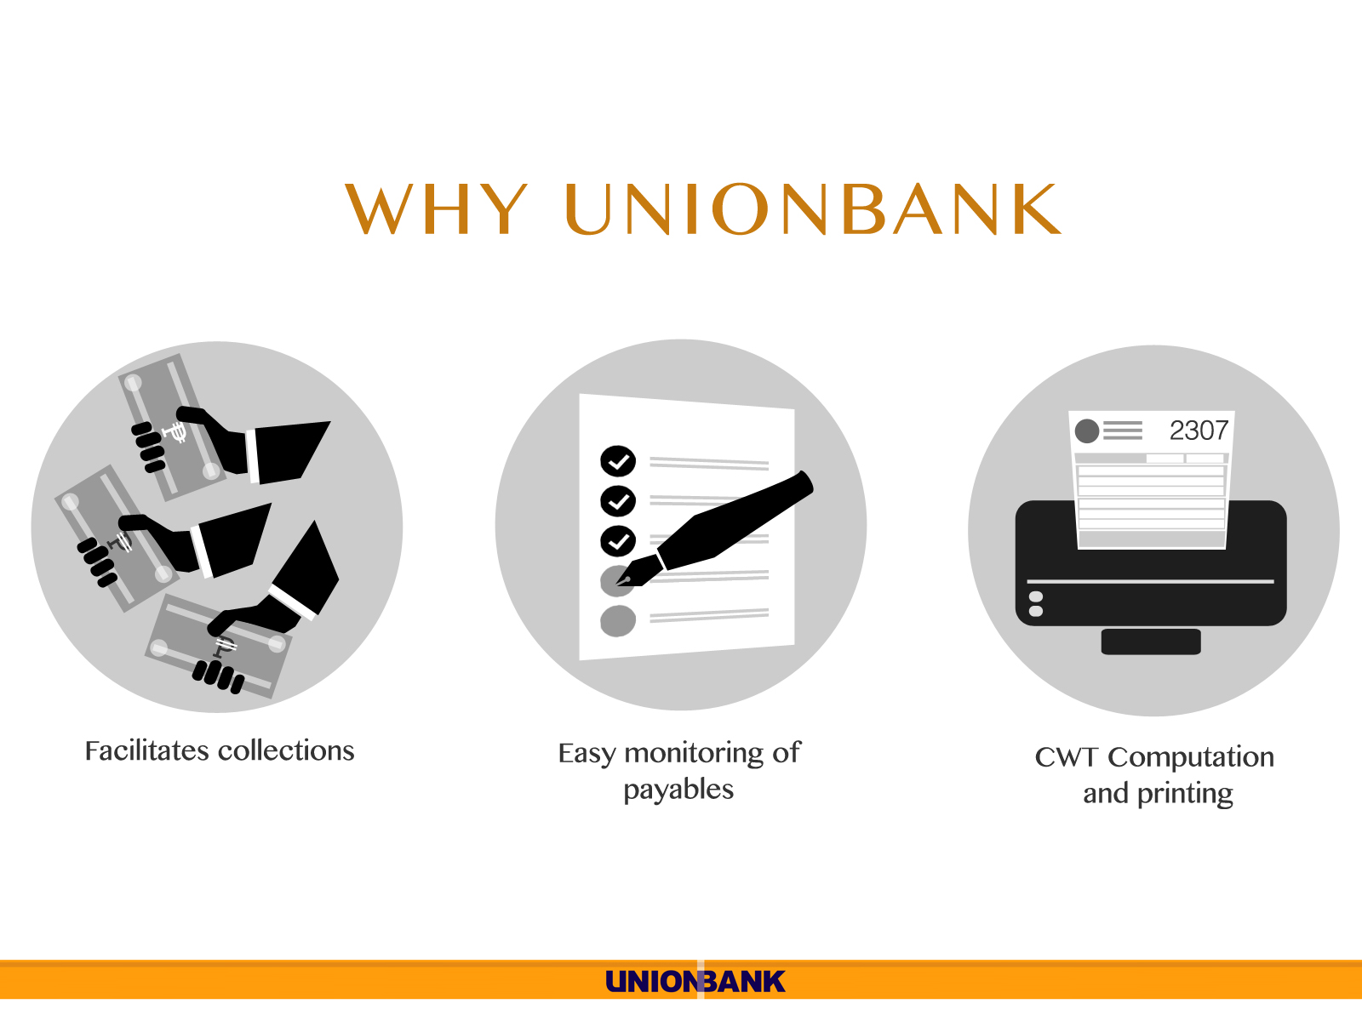

Slide 41
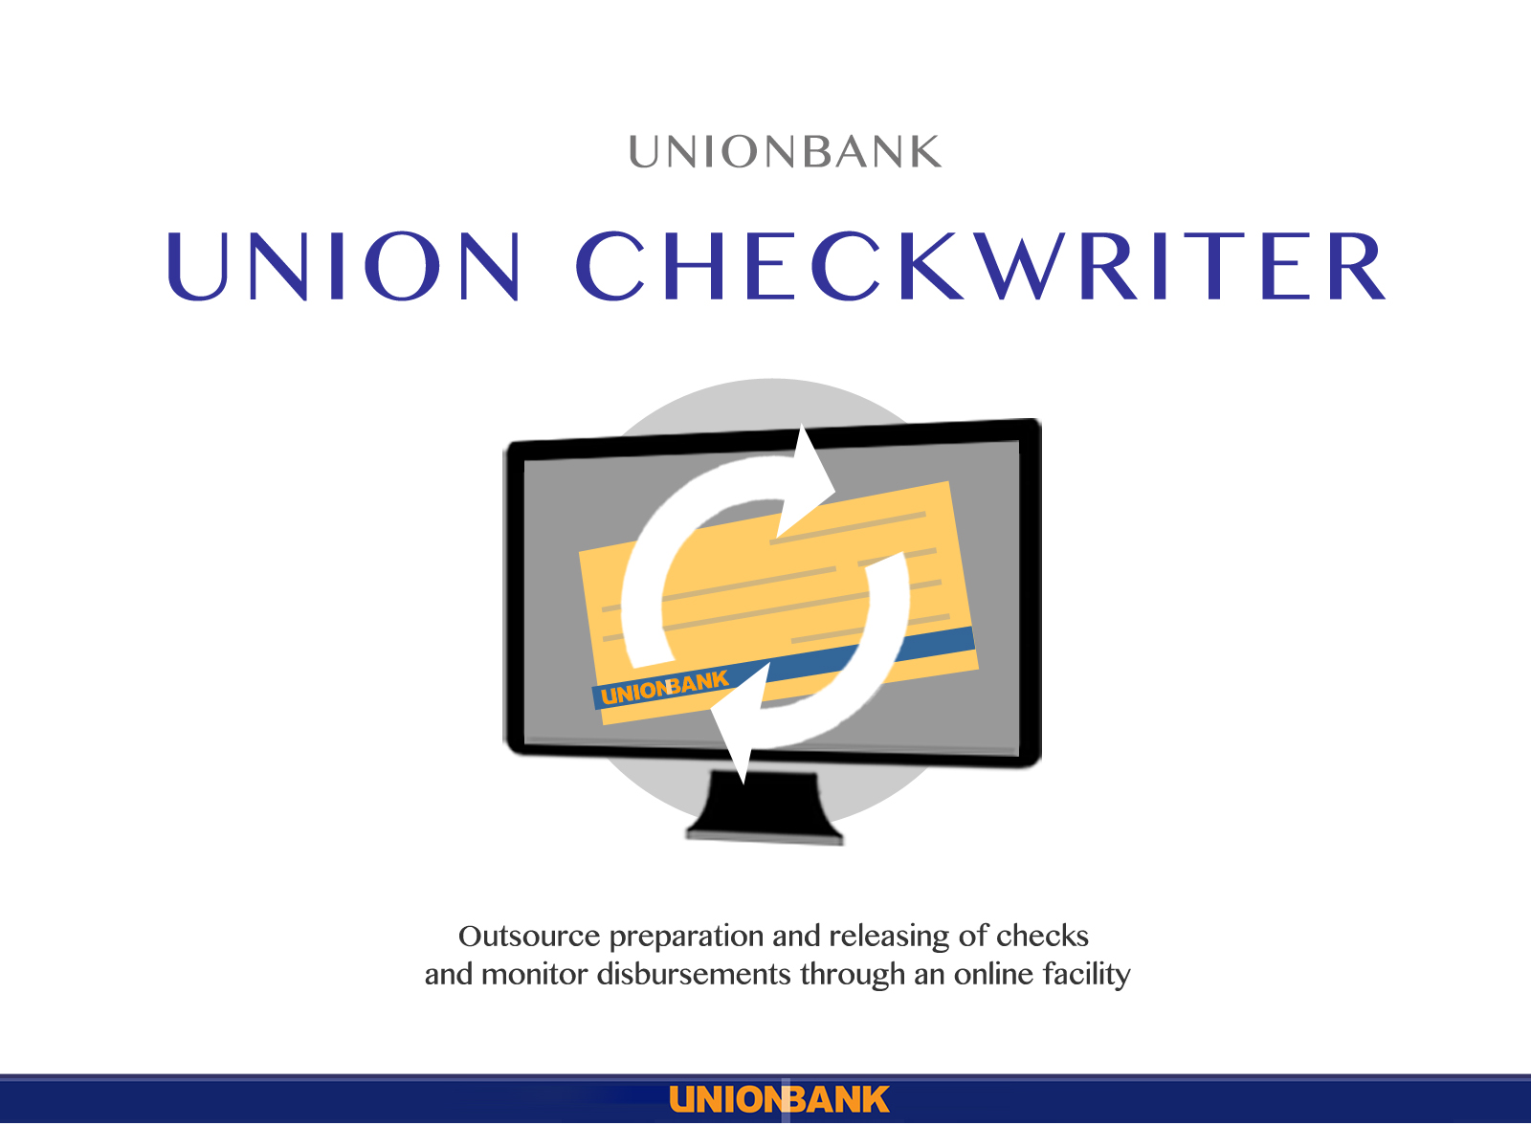

Slide 42
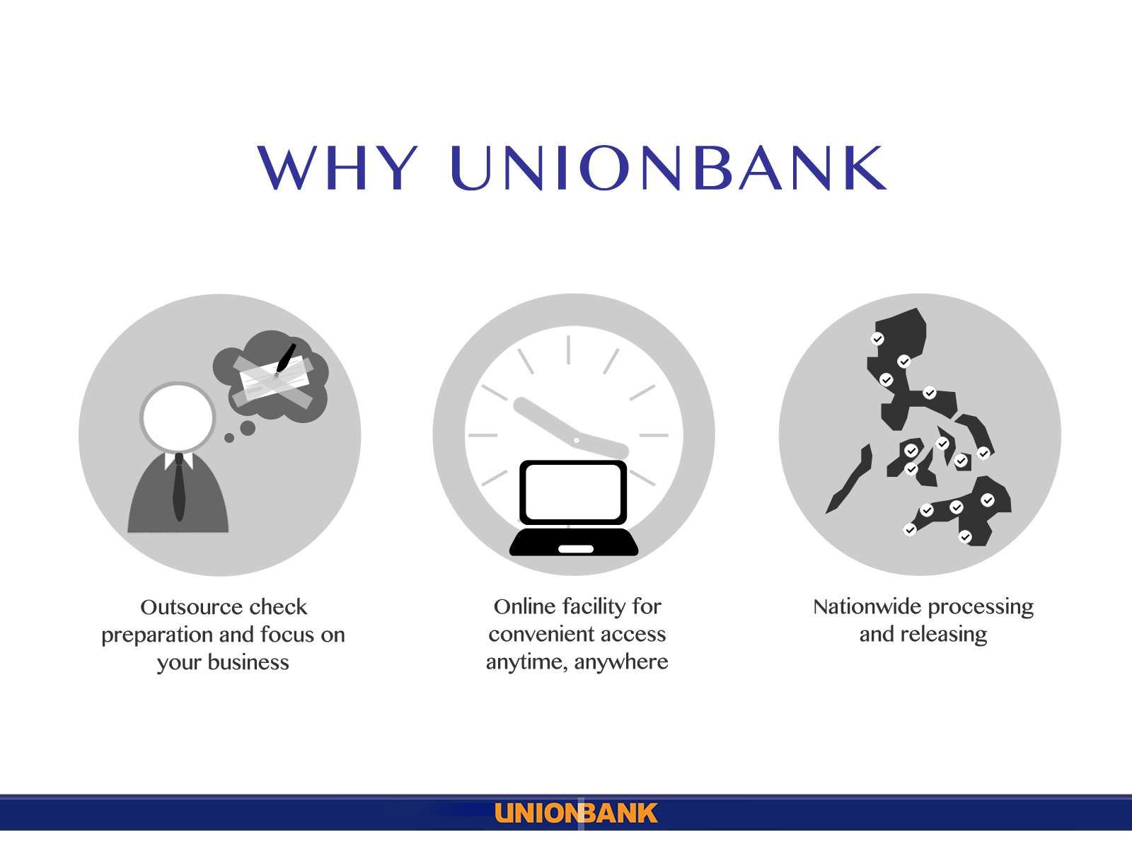

Slide 43

UnionBank Business Check
a check writing software
to streamline and simplify
your check disbursement process
from the comfort of your office
Notes:
Introducing UnionBank Business Check - a check writing software which allows you to streamline and simplify your check disbursement process from the comfort of your office.

Slide 44

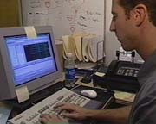
Maker
Checker
1
Logs on to Business Check
2
Encodes details of AR, voucher and check or Uploads file from A/P System
3
Logs on to Business Check
4
Authorizes checks and Assigns check numbers
5
Prints check and voucher
6
Generates reports
7
Tags Cancelled/ Spoiled/ Negotiated checks
8
Authorizes tagged Cancelled/ Spoiled/ Negotiated checks
Notes:
There are just six simple steps. Very quickly, this is how they go…

Slide 45






A S POWERTECH CORPORATION
ABS CBN FILM PRODUCTIONS INC.
ACE PACKAGING CORPORATION
ADAMSON-OZANAM EDUCATIONAL
AMERICAN CHAMBER OF COMMERCE
AMWAY PHILIPPINES
ANDOK’S LITSON CORP
ASIAN HOSPITAL INC
BISTRO ITALIANO CORPORATION
BLUE CROSS HEALTHCARE
BRANDERS.COM (PHILS) INC.
BRIGHTSTAR LOGISTICS PHILS PTE
CAPITOL MEDICAL CENTER
CARITAS HEALTHSHIELD INC.
CHIYODA PHILS CORPORATION
CREW ASIA INC.
DASH ENGINEERING PHILIPPINES
DE LA SALLE ALUMNI INC
DIOCESE OF BAGUIO
ENPRIZE HOLDING INC.
EVER BILENA COSMETICS INC.
FAIRCHILD SEMICONDUCTOR PHILS
FARMACIA FATIMA
FERN INC.
FREEWAY MOTOR SALES
GSIS PROVIDENT FUND
HYATT HOTEL AND CASINO MANILA
INFORMATION GATEWAY
INTL PHARMACEUTICAL INC
INSULAR LIFE HEALTH CARE INC.
ITALIANNI’S AYALA GREENBELT
JB MUSIC AND SPORTS
JLR CONSTRUCTION & AGGREGATES
JULIE’S FRANCHISE CORP
KAW & UNSON THE ANIMAL HOUSE
LACSON AND LACSON INSURANCE
BROKERS,INC.
LEXMARK INTL (PHILS.) INC.
LOYOLA PLANS CONSOLIDATED INC.
MACTAN DOCTORS’ HOSPITAL INC
MAKATI MEDICAL CENTER FAMILY
MANILA ADVENTIST MEDICAL
CENTER
MANILA POLO CLUB
MAPFRE INSULAR INSURANCE CORP MCCANN WORLDGROUP PHILS.
METALCREST INCORPORATED
NEGROS SUGAR FARMERS
MULTIPUPOSE COOPERATIVE
OEP PHILIPPINES INC
PALAFOX ASSOCIATES
PAMPANGA 1 ELECTRIC COOP
PATIENT CARE CORP
PIONEER LIFE INC.
PLDT EMPLOYEES CREDIT COOP INC.
RAMON ABOITIZ FOUNDATION
RAMS HOUSE OF WINE INC.
ROMAN CATHOLIC ARCH OF CEBU
SALES TEAM MARKETING INC.
SAN BEDA COLLEGE OF
ALABANG
SAN MIGUEL CORP RETIREMENT
SOUTHERN INDUSTRIAL GASES
ST. PETER LIFE PLAN
SUBIC ENERZONE CORP
SYCIP GORRES AND VELAYO CO
TECHNOLOGICAL INSTITUTE OF
THE PHILIPPINES
THE AMALGAMATED TRADING
CENTER
THE ZUELLIG FOUNDATION
UNIOIL PETROLEUM PHIL INC.
UNIVERSITY OF BAGUIO
UNIVERSITY OF ST. LASALLE
(BACOLOD)
VALUE CARE HEALTH SYSTEMS
V CUSTOMER SERVICES INDIA
PVT. LTD
VICTORY CHRISTIAN
FELLOWSHIP
VIRLANIE FOUNDATION INC
WATERFRONT CEBU CITY
WESTERN WATS PHILIPPINES
WDC FINANCE CORPORATION
WORLD CITI INC.
YELLOW CAB FOOD CORP
YOKOHAMA TIRE PHILIPPINES
More than 3,700 Clients
and Growing!!!
As of Oct 2010

Slide 46

UnionBank Business Deposits
is a multi-channel collection facility accept payments from corporate customers and sales agents
anytime, anywhere.
Notes:
Introducing UnionBank Business Deposits - a multi-channel collection facility that enables you to accept payments from your corporate customers and sales agents anytime, anywhere.

Slide 47
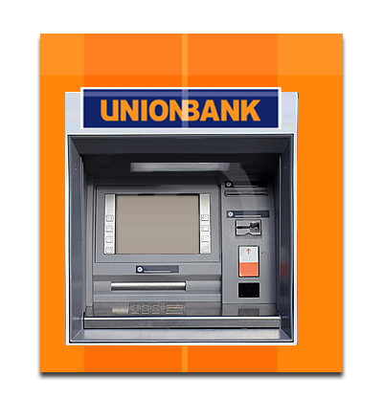
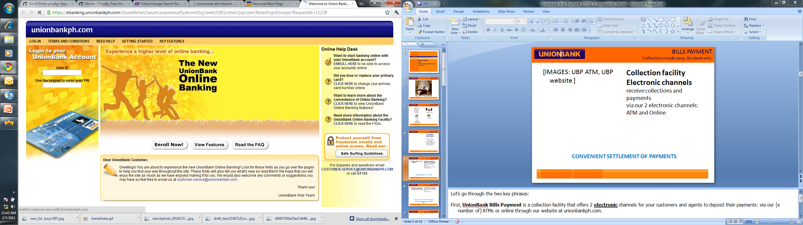
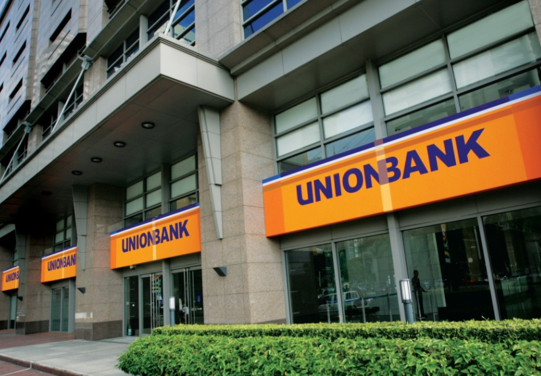
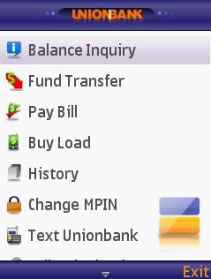
Multi-Channel Collection Facility:
Receive collections and payment via our 4 channels
ATMs
Internet
OTC
UMobile
CONVENIENT SETTLEMENT OF PAYMENTS
CLEAR THE QUEUES AND FREE UP RESOURCES
Notes:
Let’s go through the two key phrases:
First, UnionBank Business Deposits is a collection facility that offers 3 additional channels for your corporate customers and sales agents to deposit their payments: via our [x number of] ATMs, online through our website at unionbankph.com, or over-the-counter at our [x number of] branches nationwide.
The main benefit for your customers and sales agent is convenient settlement of payments, since they now have 3 additional options.
For your company, this means you can support your existing collection offices to clear the queues and free up resources.
This saves time and money for your company and your customers and agents.

Slide 48



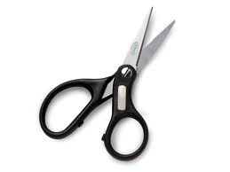

Save time
Improve relations
Improve cash flow
Cut cost
Work faster
Notes:
What if there’s a solution that…
Saves you and your customers and agents time
Cut your overhead expenses
Improve your cash flow
Build a better reputation and relationship with your customers and agents
And allow you to work faster and much more efficiently

Slide 49

Preferred Client Program
Car and Home loan attractive packages for your employees
Notes:
Auto Loan Program. Finance the purchase of a brand new motor vehicle
Home Loan Program. Finance purchase of residential unit from accredited/ reputable developers

Slide 50






Smart. Simple. Savings
Employees apply for loans & get approval without leaving the workplace
Higher home loanable value up to 90% of total contract price
Lower car monthly amortization
Customize to cover your requirements
Exclusive Car & Home Fair Events
Special insurance packages

Slide 51
Quick and Easy
Company
Define eligible employees
UnionBank
Customize proposal
Sign Loan Program
Sign Loan Program
Communicate program to employees
Communicate program to employees
Accept loan applications
1
2
3
4
5
Notes:
;

Slide 52


Slide 54
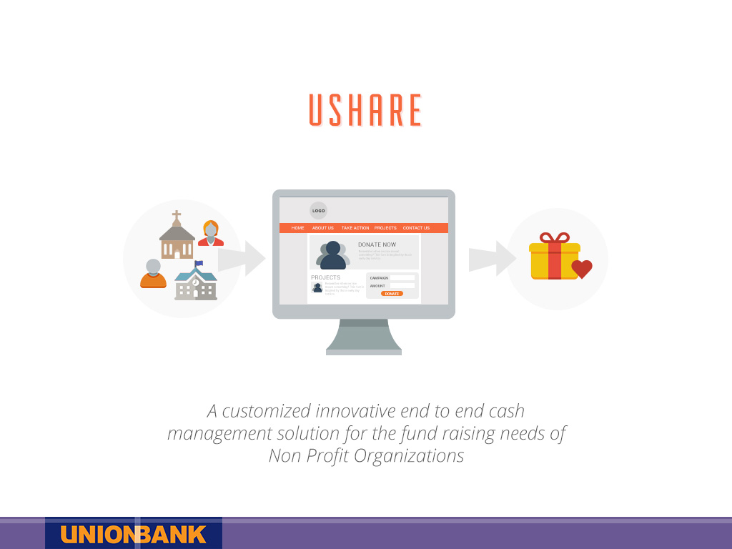

Slide 55
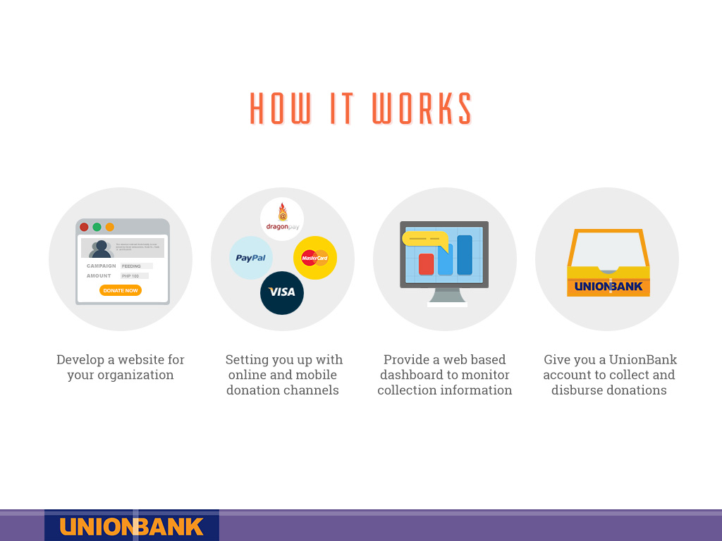

Slide 56
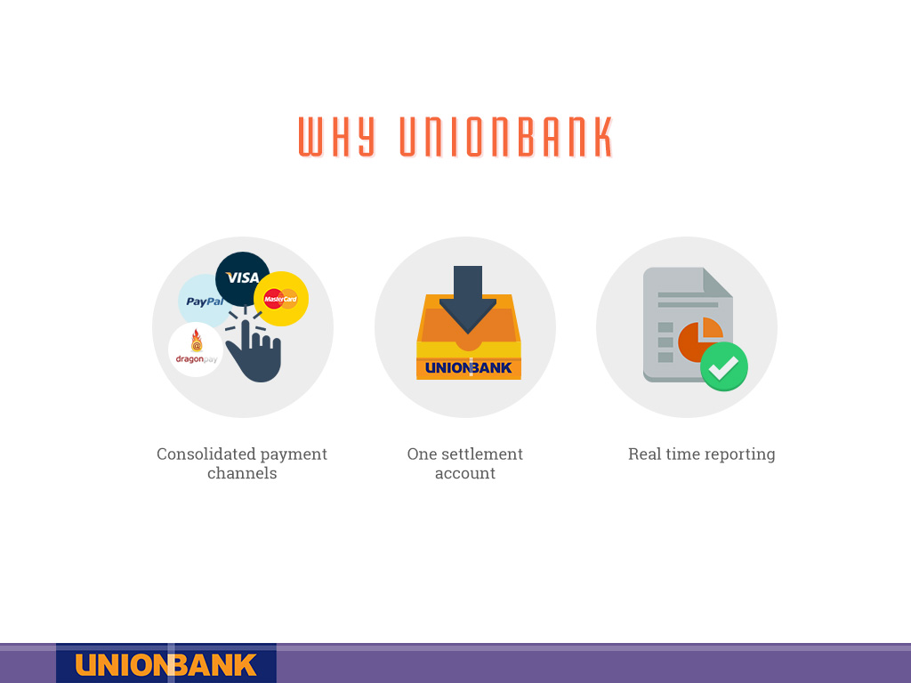

Slide 57


Slide 58


Slide 59


Slide 60
UnionBank Trust & Investments Overview
Various products and services include advisory services & investment products, including top performing Unit Investment Trust Funds (UITFs)
Regarded as among the best fund management houses in the country (sources: Lipper, Bloomberg, etc.)
UnionBank Trust & Investments
60

Slide 61
UnionBank Trust Products Overview
Trusteeship/Fiduciary Activities
Agency Functions
Unit Investment Trust Funds
- Personal Trusts – Living Trust
- Institutional Trust
Employee Benefit Trusts –
- Retirements Funds
- Pre need accounts
- Investment Management Agreements (individual and Corporate)
- Escrow Agreements
- Safekeeping
Large Cap Equity UITF
Index Tracker UITF
Balanced Fund
Dividend Play UITF
Peso Fixed Income Fund
Peso Short Term Fixed Income
Intermediate Term Fixed Income
Long Term Fixed Income
Tax – Exempt UITF
Infinity Prime
Dollar Bond Fund

Slide 62

LIST OF UBP UITF PRODUCTS

Slide 63

LIST OF UBP UITF PRODUCTS

Slide 64

UBP Large Cap UITF vis-à-vis its Peers (as of Nov 10, 2014)
Source: Bloomberg
64
Notes:
64
Updated but lack data.

Slide 65

UBP Balanced Fund UITF vis-à-vis its Peers (as of November 09, 2014)
Source: Bloomberg
65
Notes:
65
Updated but lack data.

Slide 66

UBP Fixed Income UITF vis-à-vis its Peers (as of Nov 09, 2014)

